Slide 1
Callisto™ introduction
Introduction to users

Slide 2
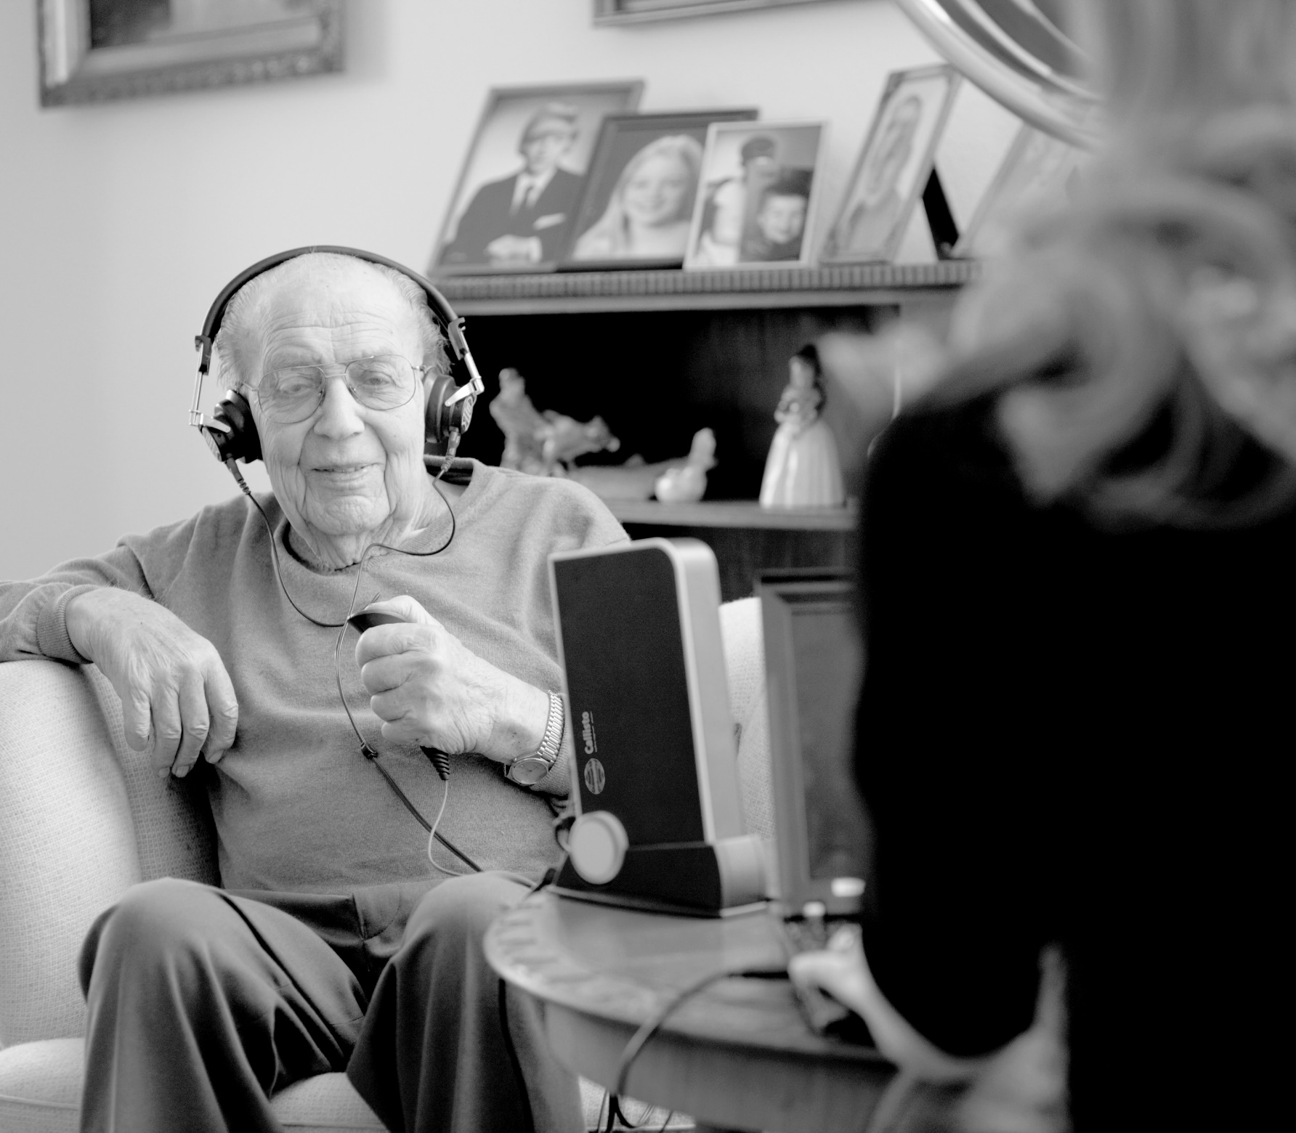
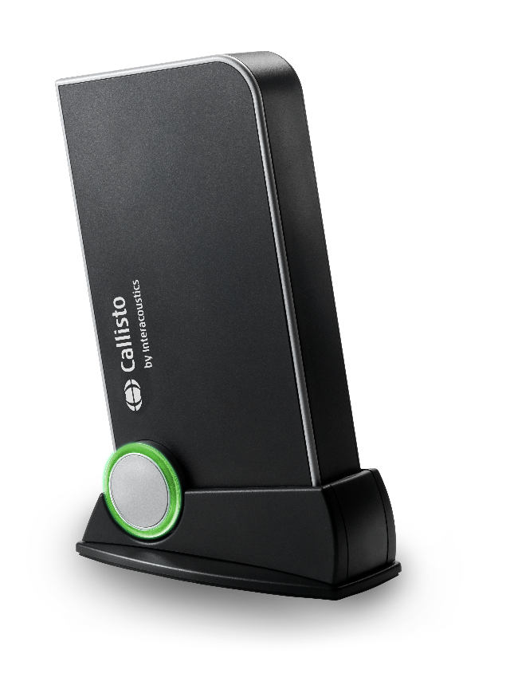
Introduction to Callisto
A fully portable solution that offers diagnostic audiometry, real-ear measurement, visible speech mapping and hearing instrument testing.

Slide 3
Callisto highlights
Contemporary, discrete design that fits into the modern office
User friendly and intuitive system that combines advanced testing and counseling features
Modular: design the Callisto™ to include Audiometry, HIT, REM, or all
Tailor the system to your needs
Support for the Viot™ Video Otoscope
Noah 3 & 4 compatible
Ideal for the travelling clinician (small footprint and light weight - 565g/1.25 lbs)
Powered directly from the PC (USB connection)
Dedicated carry bag with (option) or without wheels (standard) – leave the Callisto™ in the bag during testing.

Slide 4
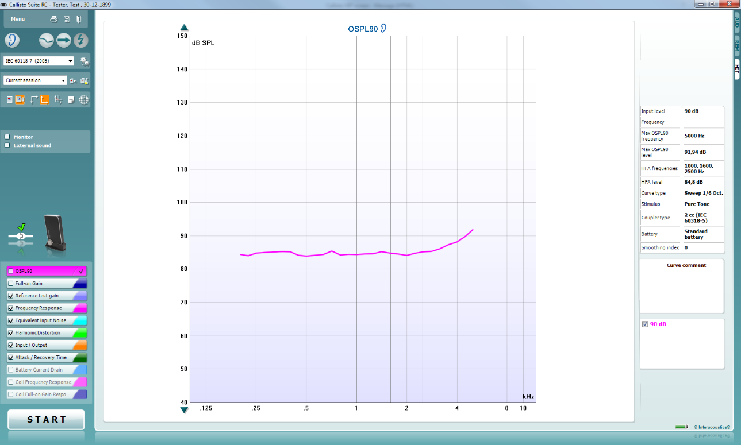
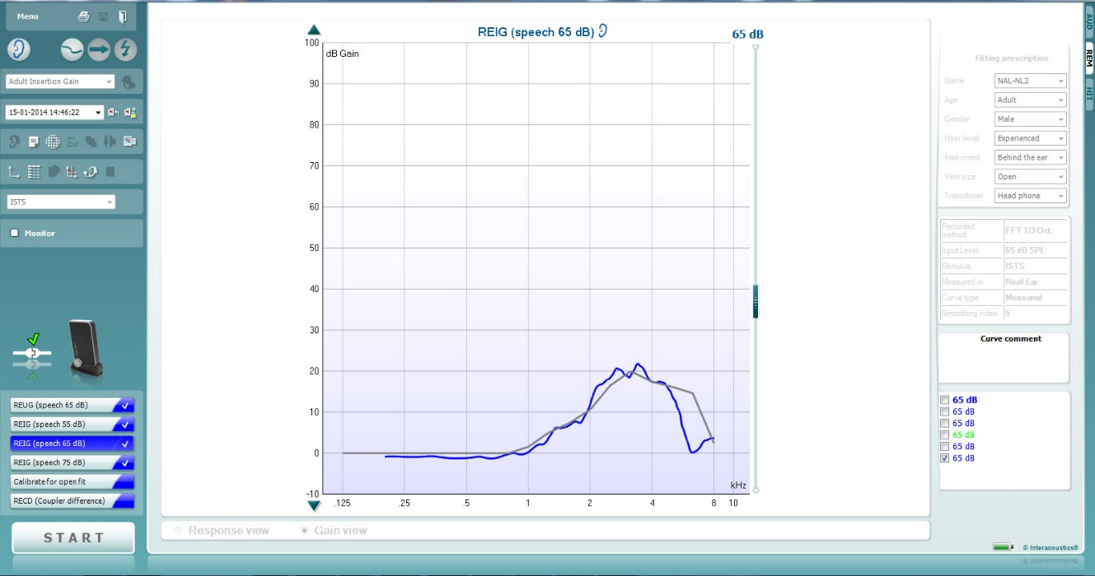
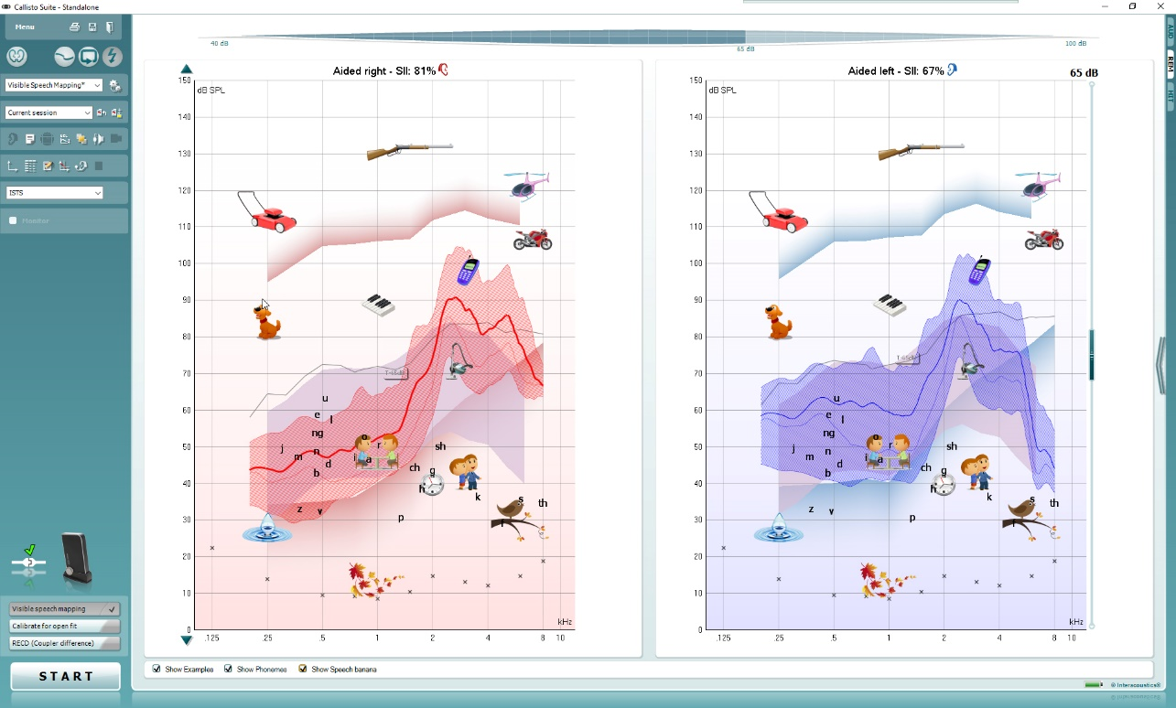
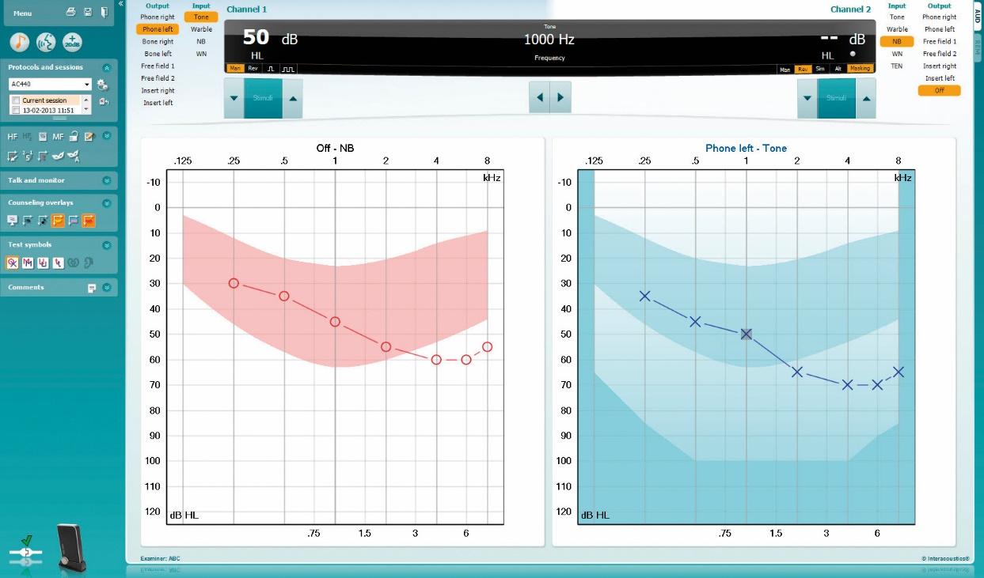
Callisto suite
ViotTM
Audiometry
REM
Visible speech mapping
HIT
Hearing instrument testing
Real-ear measurement
Visible speech mapping
Audiometry

Slide 5
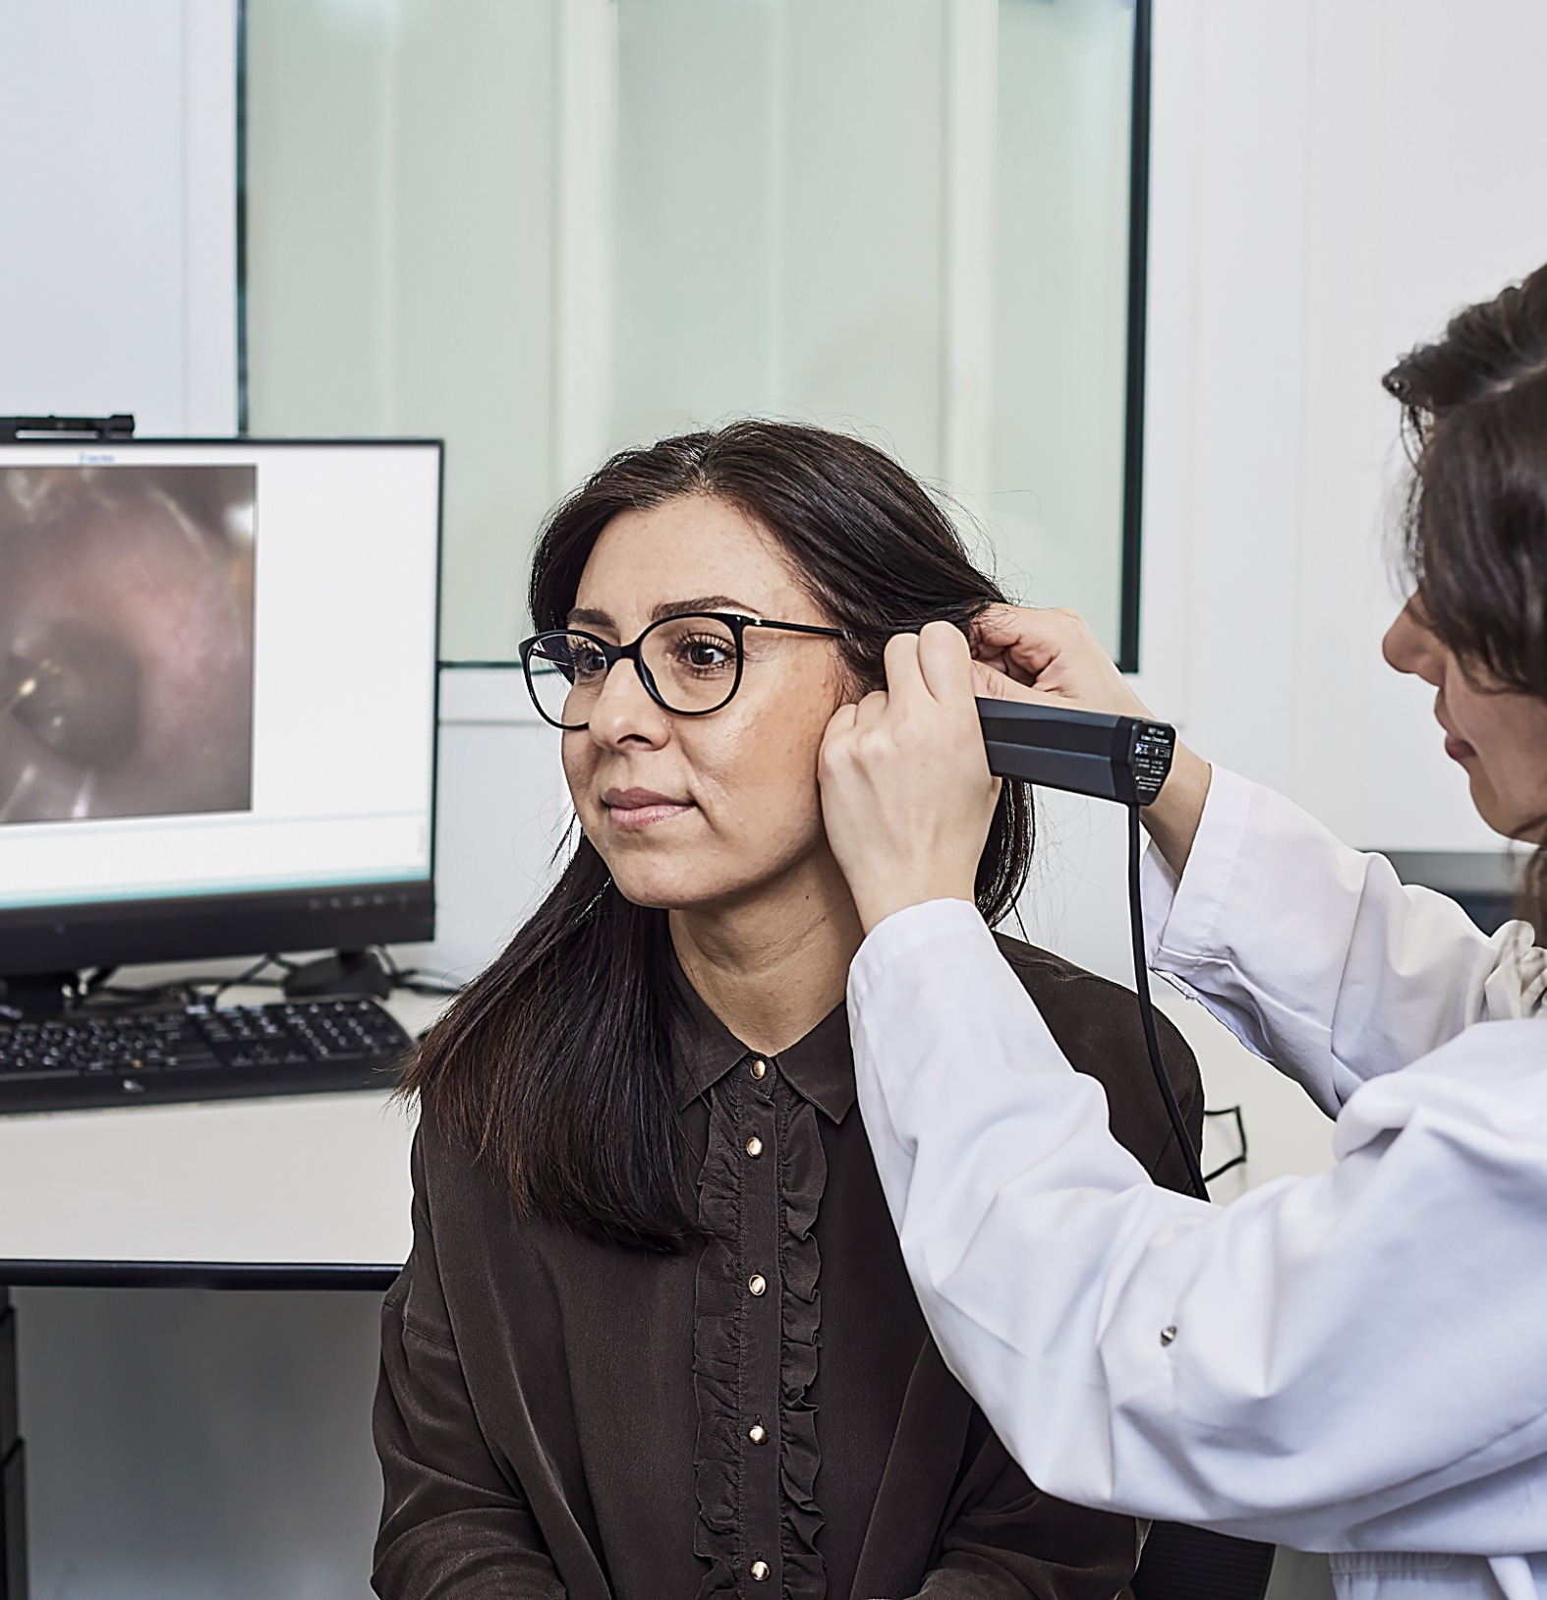
Viot™ compatibility
Connect Viot™ to the PC/laptop and ‘VO’ tab will appear.

Slide 6
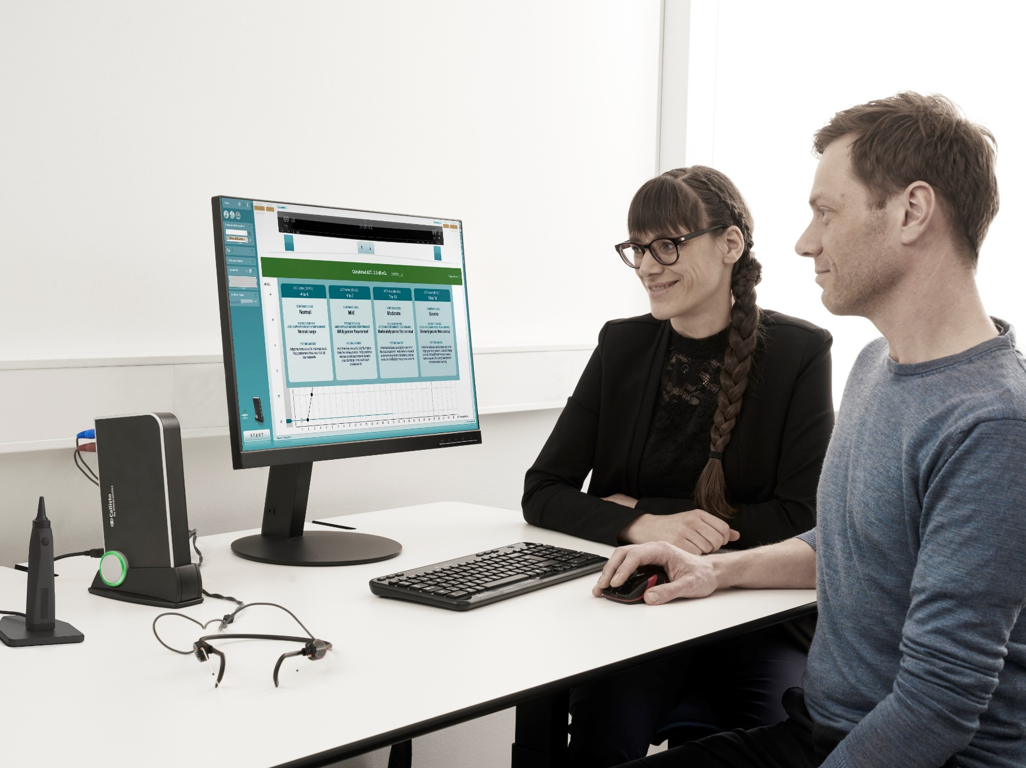
Audible Contrast Threshold (ACT™) test on Callisto
Conversations made clearer
The ACT test is an above-threshold, non-language specific test that quantifies a person’s real‑world ability to hear in noise.
Use the ACT value to counsel clients on how to manage their hearing-in-noise ability, including automatic prescription of adaptive features in selected hearing aids.
ACT is standard on the Callisto Audiometry module.

