Slide 1
DATA Model: A Clinician-Based Approach to Best Patient Care

Slide 2



What is the DATA model?
A framework for care that utilizes patient-specific objective data to support clinical decision-making for intervention and follow-up
“Good data in equals good data out”
Notes:
The DATA model represents a four-step patient care approach where the clinician utilizes objective information to direct a patient from diagnosis to training and beyond. Following this approach enables clinicians to make informed, objective and data-driven decisions to enhance their patient’s quality of life

Slide 3
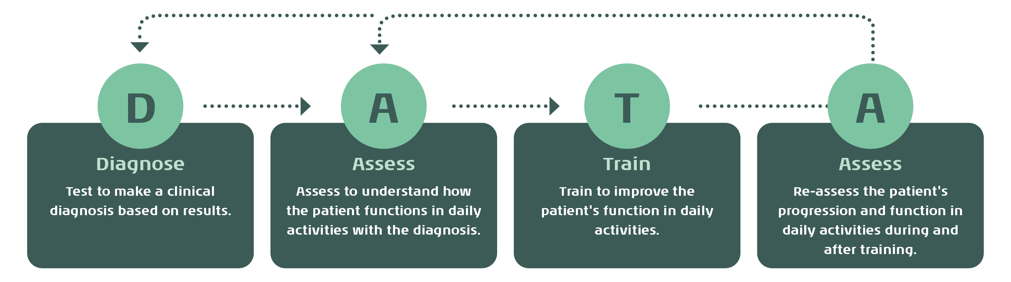
What are the components of the DATA model?

Slide 4
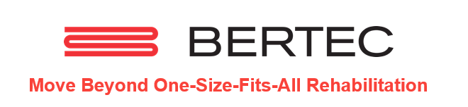

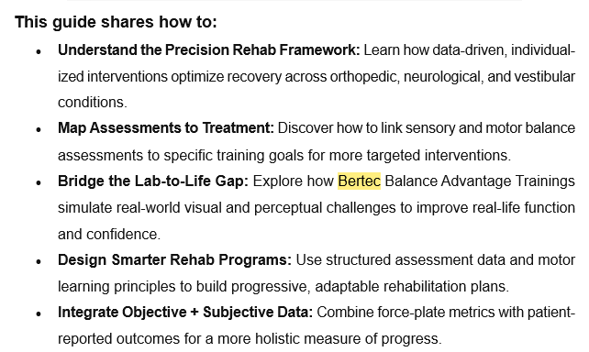
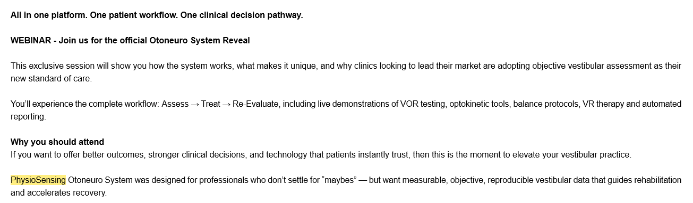
Why did we create the DATA model?
Differentiation for Interacoustics = DATA model

Slide 5
Why should clinicians use the DATA model?
Helps determine an accurate diagnosis
(Dizziness is a symptom, not a diagnosis)
Non-specific or inaccurate diagnoses can lead patients down the wrong road
Accurate diagnosis leads to appropriate intervention and follow up

Slide 6
Why should clinicians use the DATA model?
Right care
Accurate diagnosis leads to correct intervention
Right time
Improved time management for the patient and professional
Right professional
Correct triage to trained professional
Right tools
Comprehensive diagnostic, assessment and training equipment to support the patient’s recovery
Ensures patients receive the right care at the right time by the right professional using the right tools

Slide 7
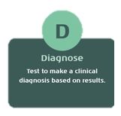
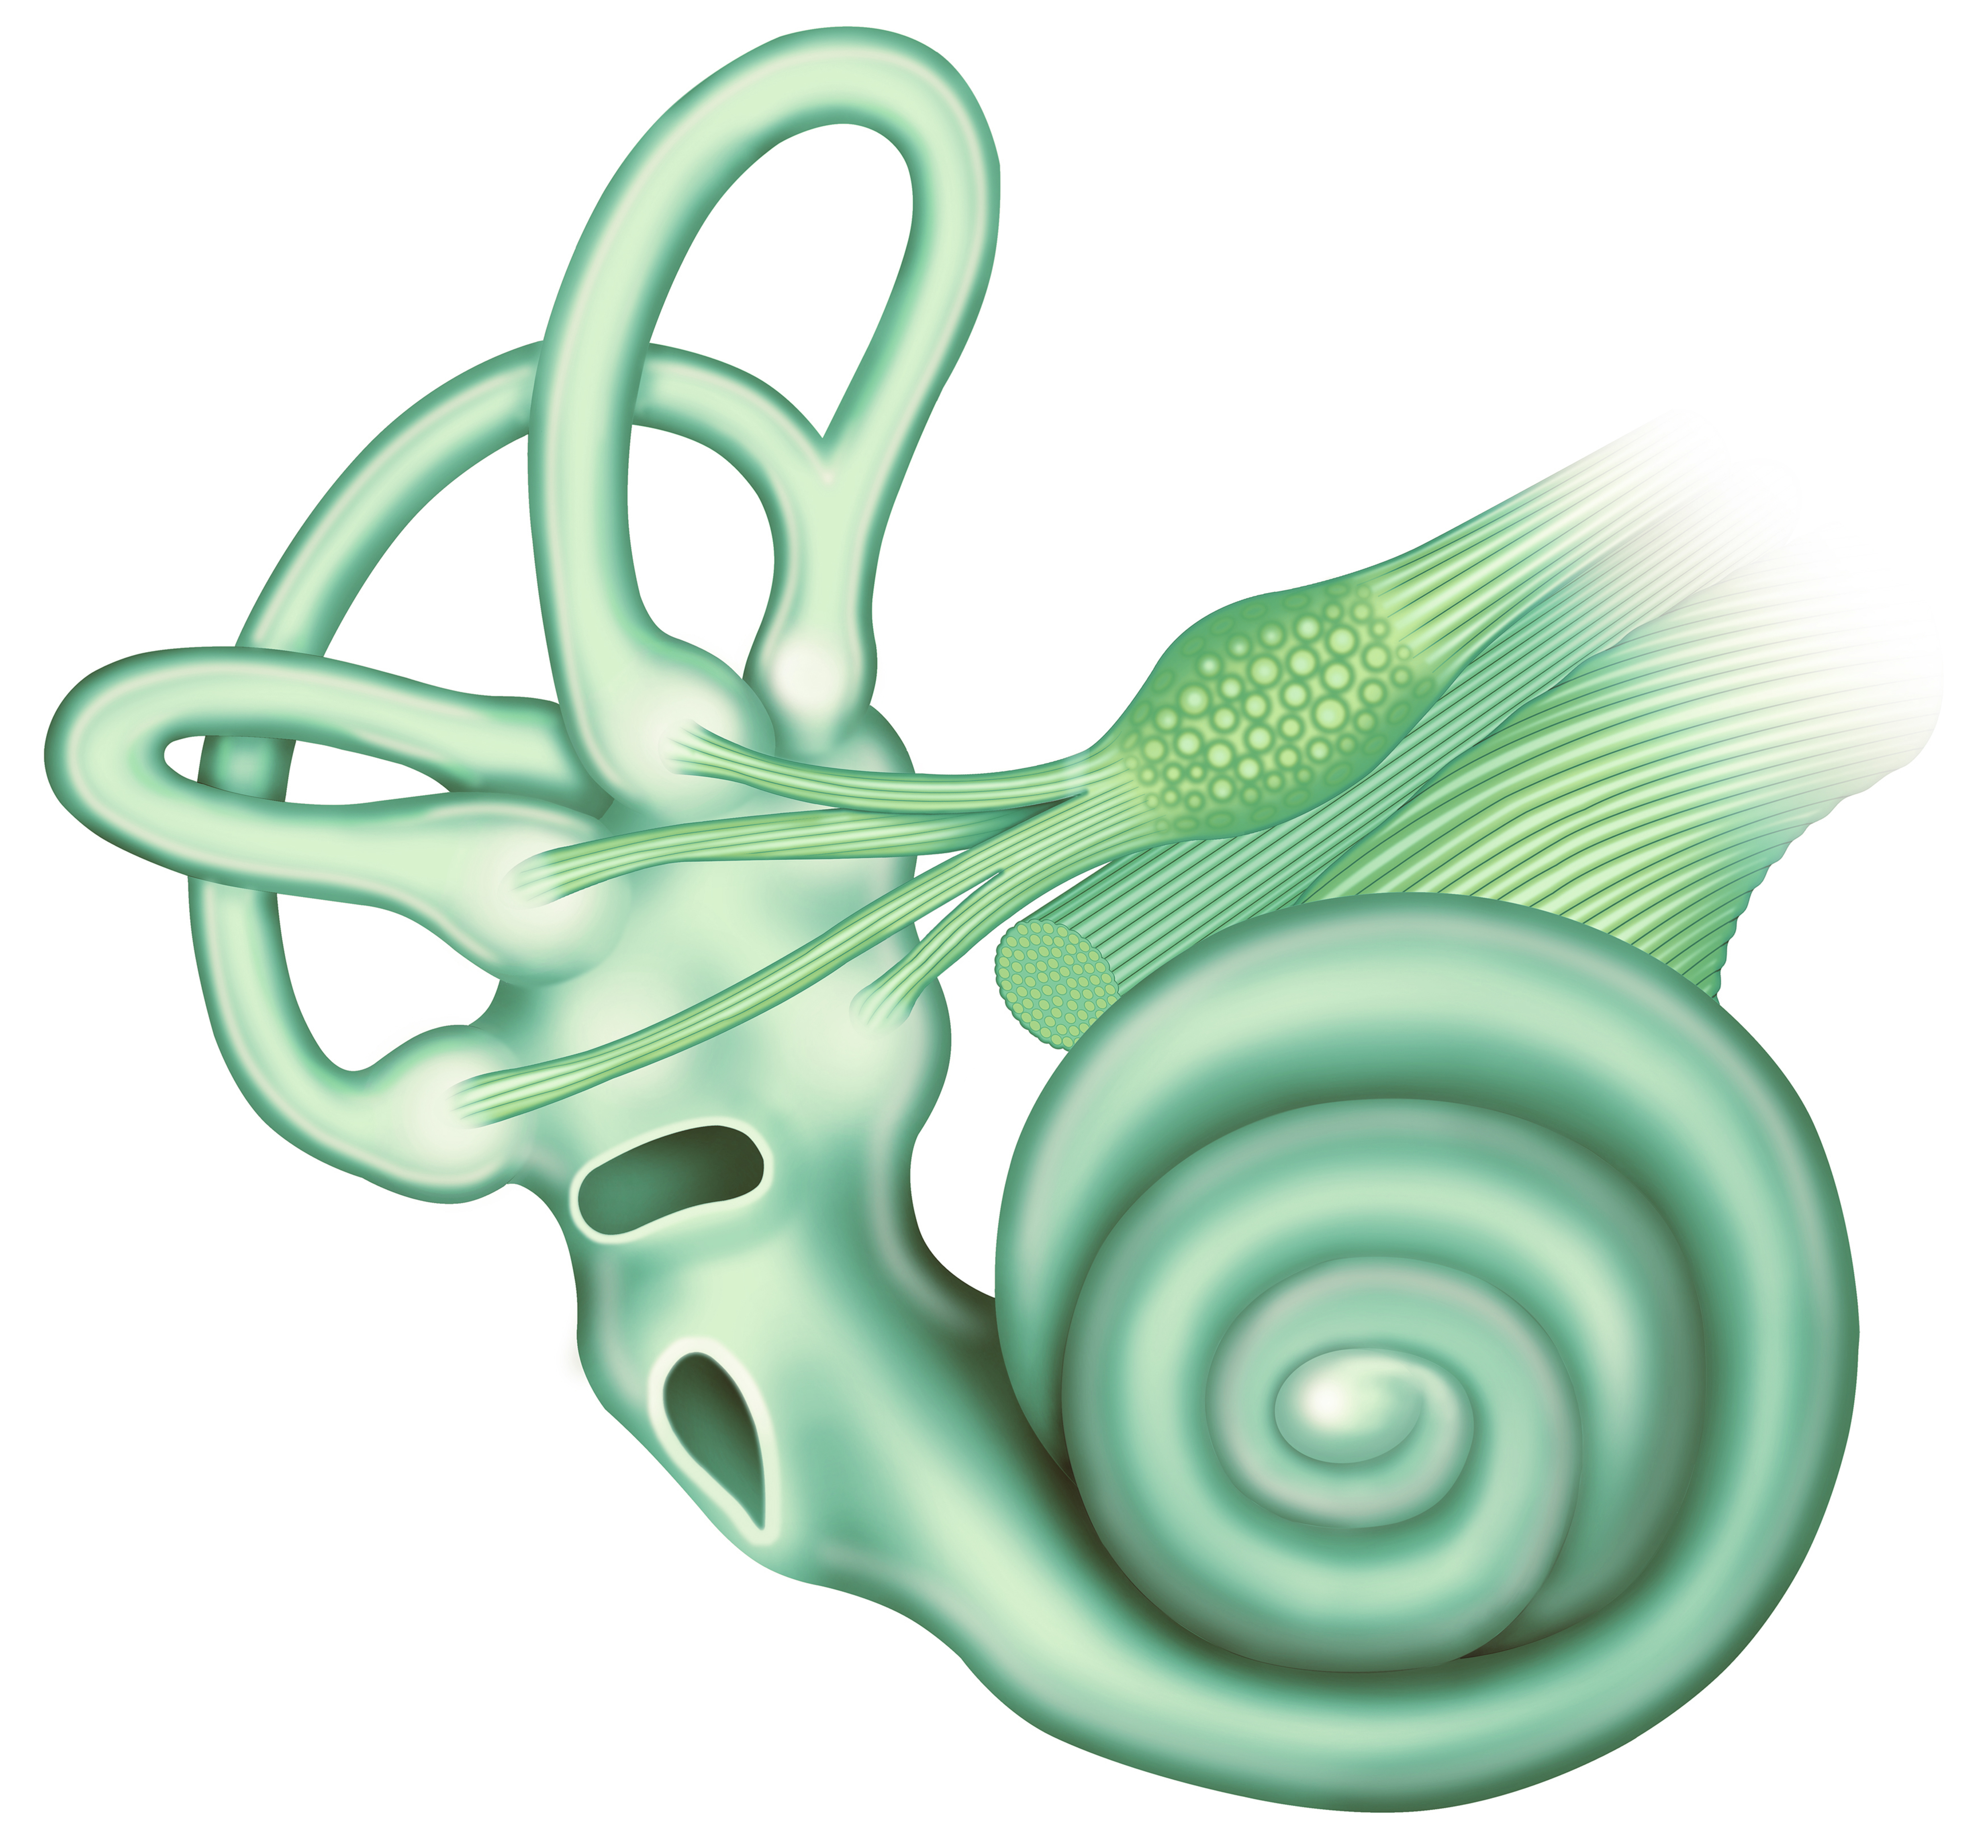

Diagnose: Step 1
Identify a clinical diagnosis based on site of origin
Utilize precise diagnostic tools for comprehensive assessment
VNG, Rotary chair, vHIT, Calorics, VEMPs, VORTEQTM Assessments/Diagnostics
Objective results provide optimal and accurate foundation for developing effective rehabilitation plan for the patient
Notes:
When any patient enters your clinic with symptoms, the first important step is to identify a clinical diagnosis based on site of origin. For dizziness, and especially vestibular disorders, diagnostic tests allow us to accurately identify site of origin for the potential disorder. In vestibular testing, we are utilizing a variety of precise diagnostic tools to ensure a comprehensive assessment of the peripheral vestibular organs. These tools include videonystagmography, rotational chair, video head impulse (vHIT), caloric, and vestibular evoked myogenic potential (VEMP) testing.
Diagnostic testing allows clinicians to determine the function of certain parts of the peripheral and central vestibular system. Objective results from this testing provide an optimal and accurate foundation for developing an effective treatment plan for the patient

Slide 8
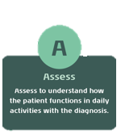
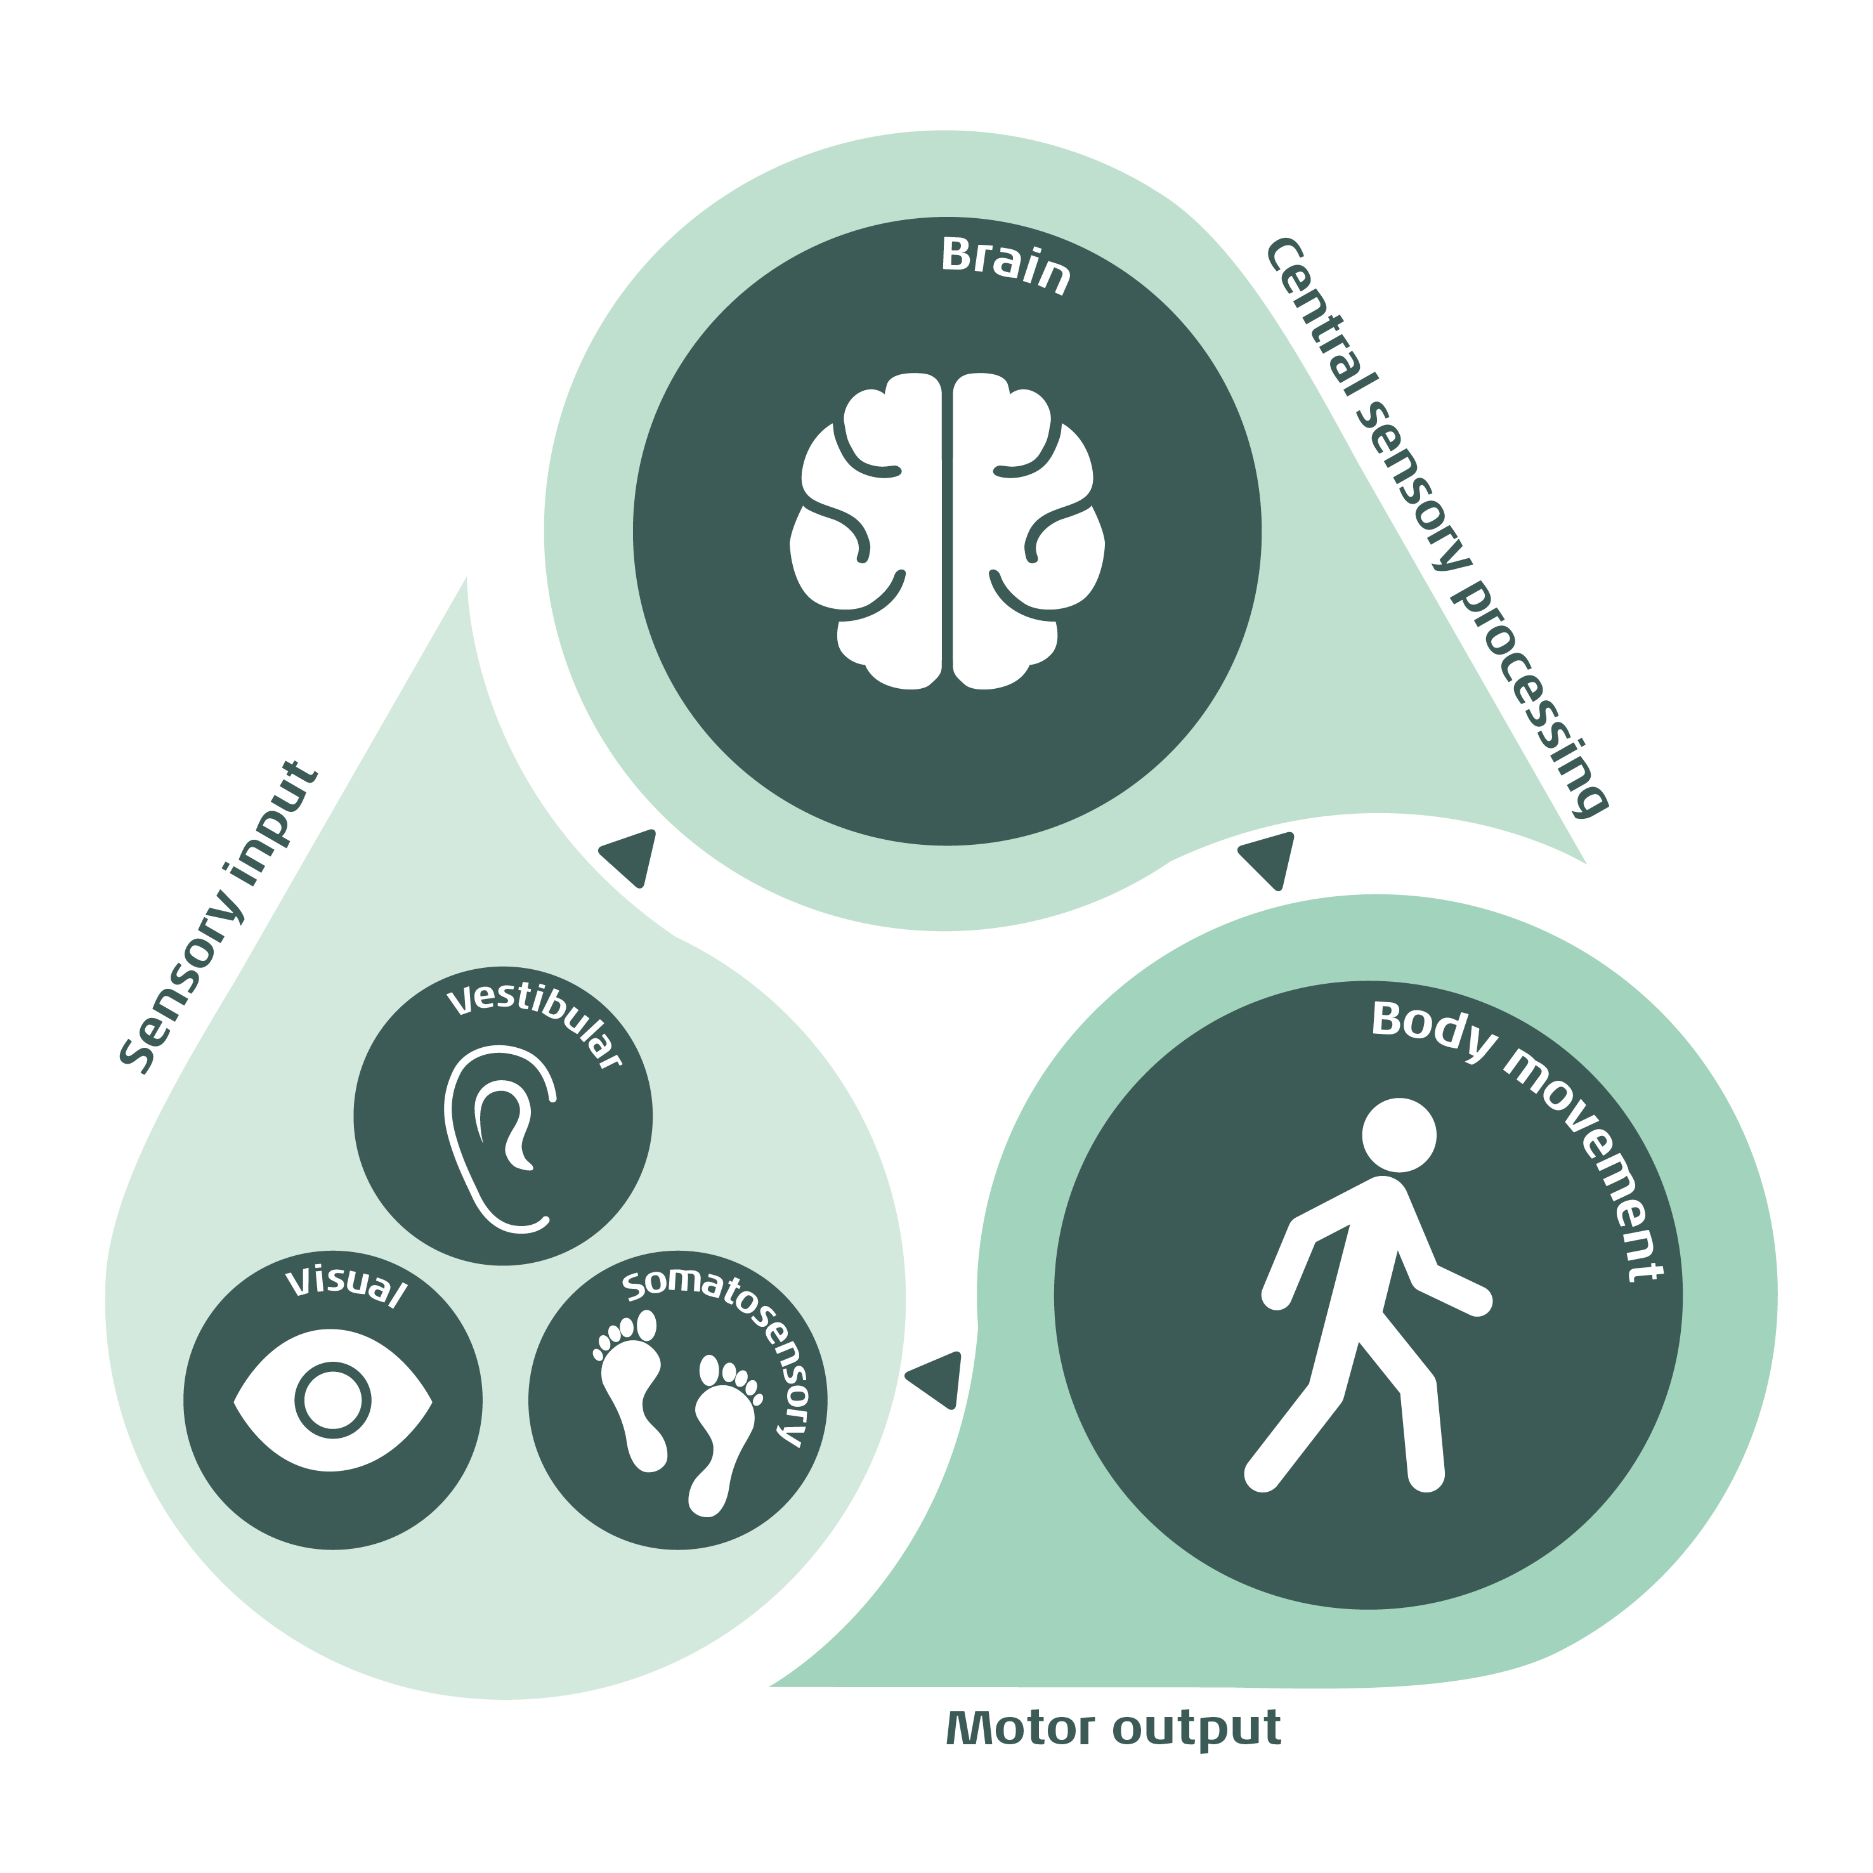
Assess: Step 2
Understand how the patient is functioning in their daily activities with their clinical diagnosis
Important to assess entire balance system: sensory input, central processing and motor output
VORTEQTM Assessments (DVA/GST/fvHITTM), Virtualis assessments (SOT/CTSIB, MCT, ADT, LOS)
Objective data to initiate and modify customized training programs
DVA: Dynamic Visual Acuity, GST: Gaze Stabilization Test, fvHITTM : Functional Vision Head Impulse Test, SOT: Sensory Organization Test, CTSIB: Clinical Test of Sensory Interaction on Balance, MCT: Motor Control Test, ADT: Adaptation Test, LOS: Limits of Stability
Notes:
Once a clinical diagnosis is established, the next step involves assessing how the patient is functioning with their clinical diagnosis. Two patients may have the same origin site of dysfunction but may experience different degrees of functional limitations. Depending on the patient and their specific diagnosis, the clinician may need to assess one or more areas such as gaze stability, sensory organization, and balance control. These assessments include computerized dynamic visual acuity or gaze stabilization testing utilizing a head worn VORTEQ sensor and limits of stability with clinical dynamic posturography assessessments using the Virtualis static or dynamic platforms.
It remains crucial for clinicians to rely on objective data to conduct a thorough assessment and initiate appropriate training.
@Cassandra Anderson (CSAS) maybe you can fill in specific examples of the equipment used in each category

Slide 9
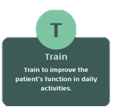
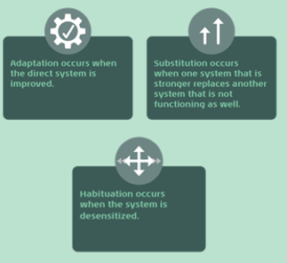
Training: Step 3
Customized to the patient based on diagnostic and assessment results
Improve the patient’s daily function, so they do not feel limited by their disorder through adaptation, substitution and habituation strategies
Virtualis virtual reality solutions
Objective data to monitor patient’s response and progress appropriately
Notes:
Following diagnosis and assessment, if training is necessary, the clinician should concentrate on exercises aimed at improving the patient's performance in their daily tasks. The goal of the training step is to improve the patient’s daily function, so they do not feel as limited or restricted by their disorder. Depending on the type of disorder or site of origin, recovery of the physiologic mechanism may not be realistic. This is why common balance rehabilitation strategies to improve function include adaptation, substitution, and habituation. Training exercises can utilize the Virtualis virtual reality headset for personalized immersive activities along with proactive and reactive postural control exercises using the Virtualis static or dynamic platforms to stimulate the full balance system.
Clinicians must closely monitor the patient's response to training and adjust exercises accordingly to ensure progression. Again, observing patient data at this stage of the process can dictate changes in training and additional interventions or strategies.
Insert equipment or exercise examples

Slide 10
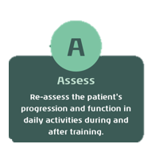
(re)Assess: Step 4
The DATA model is dynamic, requiring clinicians to reassess the patient’s status during and after training
  May involve returning to Step 1 (diagnose) and/or Step 2 (assess) depending on the patient
  Objective data plus the patient’s subjective report leads to a stronger argument for discharge
Notes:
The DATA approach remains dynamic, requiring clinicians to continually reassess the patient's daily functional status during and after training. Reassessment may involve returning to the diagnostic tests and/or additional assessment tools depending on the patient’s history and current presentation. A patient’s discharge from formalized therapy typically occurs when a patient returns to functioning in their daily activities. A stronger argument for the decision to discharge a patient is rooted in objective data and patient’s subjective improvement.

Slide 11
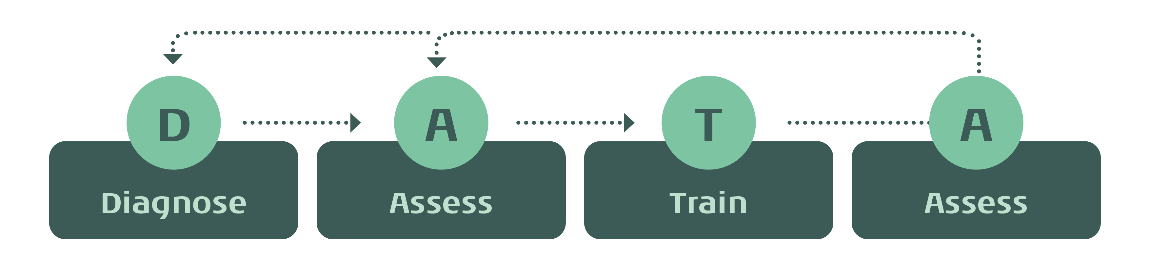
Setting the standard with a data-driven approach
The DATA model by Interacoustics
a framework for care that utilizes patient-specific objective data to support clinical decision-making for intervention and follow-up
High-quality data stored in one centralized database

Slide 12

Good data in equals good data out!
vHIT
Calorics
VNG
Rotational Chair
VOR function
Posturography
Speed
Frequency
Sway
vHIT
VOR function
Posturography

Slide 13


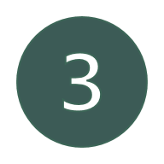
Putting it all together...
Successful use of the DATA model requires:
Knowledgeable and skilled professionals with strong clinical judgment
Comprehensive diagnostic, assessment and training tools
Precise and objective data in all steps to guide clinical decision making

Slide 14
An evolving framework...
As our products expand, machine learning models are continuously integrated and refined through ongoing research. While we don’t yet include every component of the model across all markets, this framework can be used as a foundational guide to support the patient journey.

Slide 15
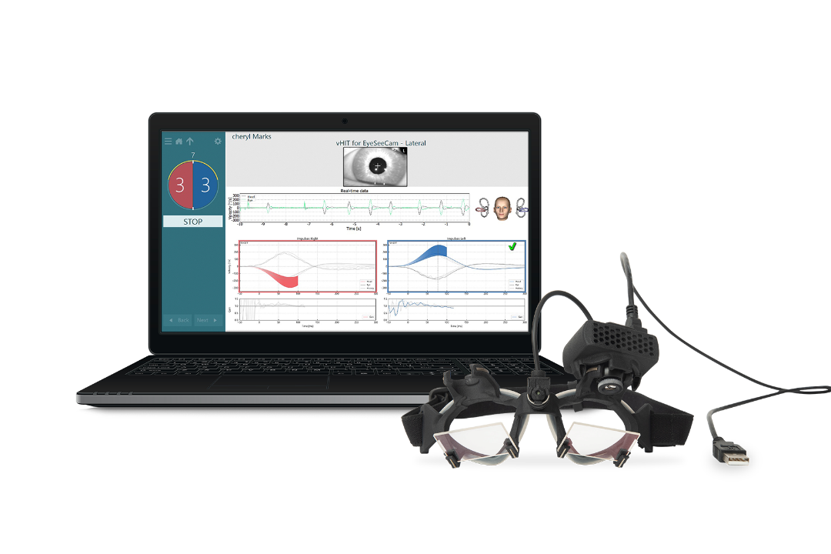
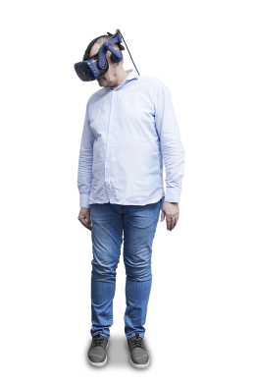
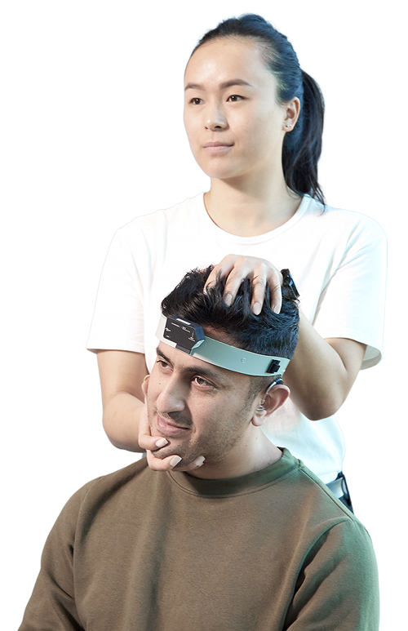
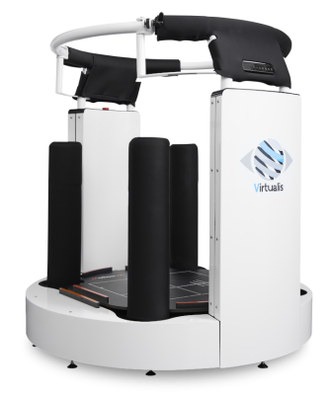
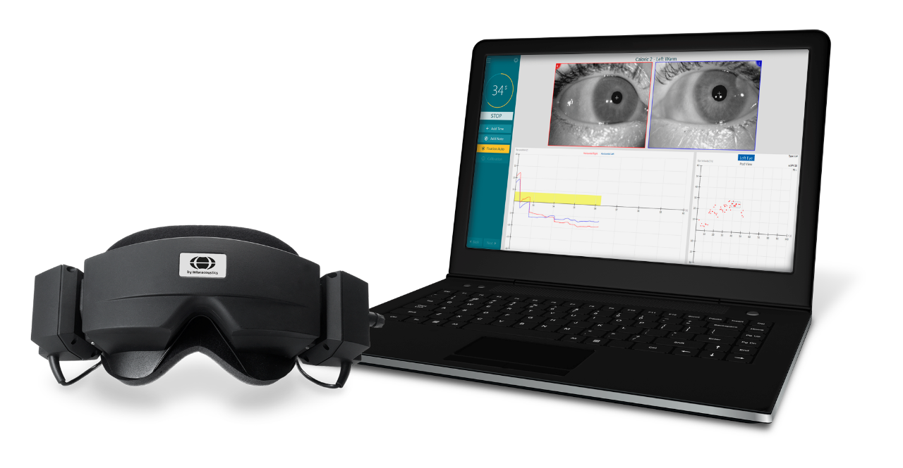
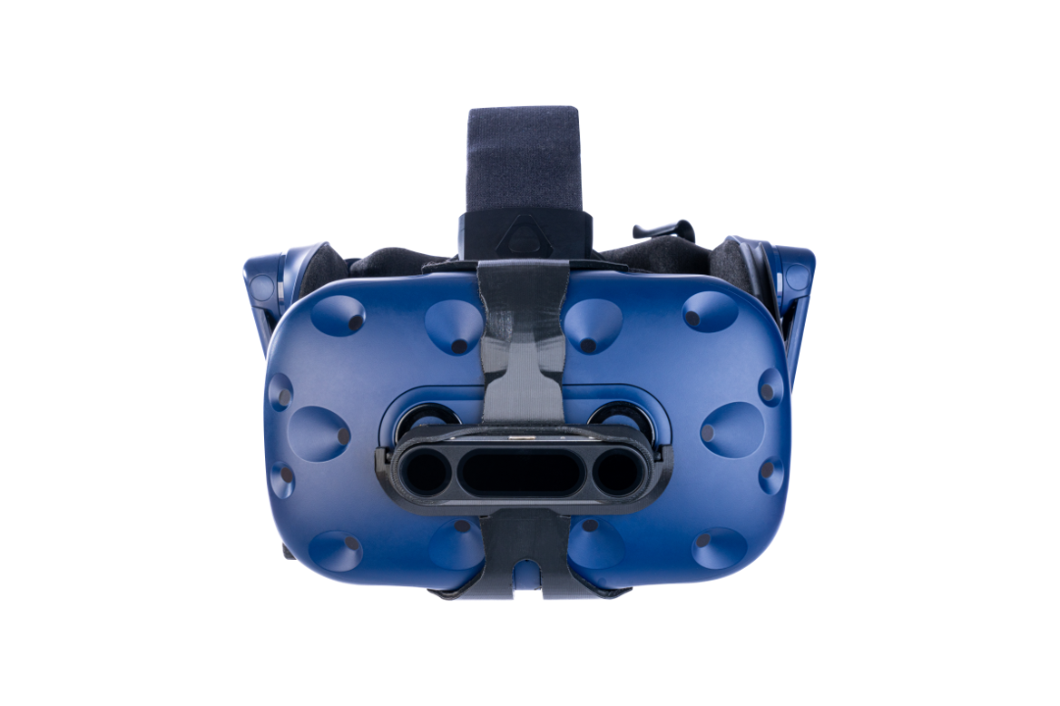
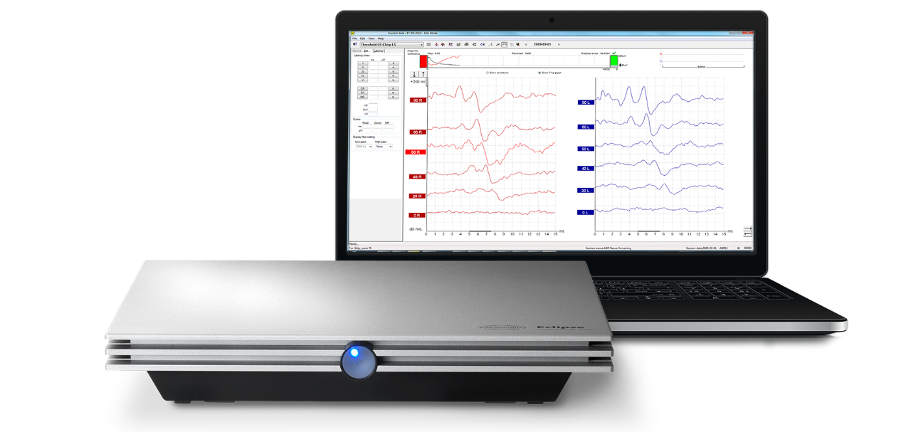
ENT typical case example – vestibular neuritis
Unilateral hypofunction on vHIT, calorics, VEMP
Impaired VOR horizontal and LARP planes
SOT – vestib pattern
Virtualis target tracking – right horizontal and LARP planes
vHIT showed improvement
VOR and SOT back to normal

Slide 16
Starting the DATA conversation with an Audiologist or ENT
Suggestions, questions and prompts for an effective sales conversation

Slide 17
Diagnostic: (RC with VNG, vHIT, VORTEQ diagnostic, Caloric, VEMPs)
Define Patient Population
What type of patients do you see most often (dizziness, neurological, balance)?
Who is your main referral partner (neurologic, ENT/otology, primary care)?
Population (pediatrics vs geriatrics)?
Identify needs
Patient Diagnostics/ Equipment
What is your protocol for diagnosing patients? What equipment do you use?
Do you have the ability to diagnose the 10 vestibular organs (5 each side – otoliths and semicircular canals) and 2 branches of the vestibular nerve?
Do you have equipment to differentiate major vestibular disorders?
Bilateral vs unilateral vestibular loss, BPPV vs migraine, etc.
Customer challenges
Ex: Rotational chair for bilateral, calorics/vHIT for unilateral
Ex. Adv DHP with sensor and torsion

Slide 18
D to A
TRANSITION QUESTIONS
Do you perform rehabilitation in your clinic, or do you refer out to another professional/clinic?
What do you do if your patient’s VNG/vHIT is normal but the patient still reports symptoms?

Slide 19
Assessment: (Virtualis SOT, MCT, Adaptation, LOS, VORTEQ assessments)
Define Patient’s
Functional Abilities
Do you ask in case history/subjective questionnaires about patient history of falls or daily activity limitations?
How often do you have patients return with unresolved or recurrent symptoms after their diagnostic appointment?
For two patients that have the same disorder (for example with vestibular neuritis), do you know how your patient performs in daily life with that disorder?
Identify needs
Patient Equipment
What equipment/tools do you use to assess the patient’s function?
Do these tools have objective results (determine frequency/side/sensory input specific)?
Customer challenges

Slide 20
A to T
TRANSITION QUESTIONS
If you do not perform objective functional assessments, do you refer the patient to somewhere else? If so, where?
If you perform training in your office, what does that look like?

Slide 21
Train: (Virtualis)
Define Patient’s Rehabilitation Journey
Do you perform rehabilitation in clinic or refer out?​
Where do you refer your patients to for rehabilitation?​
How often do you see patients returning to your clinic after rehabilitation? – ‘Why do they return?’​
Do you have cross-functional collaboration (e.g. ENT/neuro/PT)?​
If you rehabilitate, what is your process for offering a personalized rehabilitation plan?” ​
Identify needs
Patient Training Resources and Equipment
How important is technology to offer the best care for your patients?​
Do you provide any resources or tools for independent training/intervention for your patient (self-directed therapy)?​
Are you able to provide objective data to insurance/social security for reimbursement?​
Tell me about your patient’s motivation for following a rehabilitation plan.
Customer challenges

Slide 22
T to A
TRANSITION QUESTIONS
Do your patient’s symptoms improve or resolve with rehabilitation/intervention?
Do you see patients back in your office due to unresolved symptoms/or recurrent dizziness?

Slide 23
Assessment: (Virtualis SOT, MCT, Adaptation, LOS, VORTEQ diagnostics/assessments), vHIT
Define Patient’s
Functional Abilities
Do you schedule follow up appointments with your patients post-training?
How do you know when your patient is back to normal function? How do you know when to discharge patient versus refer for more training or other interventions?
Does the patient need more diagnostic testing based on unresolved symptoms? How often does your patient need repeat diagnostic testing?
Identify needs
Patient Equipment
Customer challenges
What equipment or resources do you use to assess progress after intervention?
Do these tools have objective results (determine frequency/side/sensory input specific)?

Slide 24
Conclusions for DATA for the Audiologist / ENT
Goals for this customer group:
Make sure diagnostics are thorough/comprehensive and can distinguish vestibular populations
Assessment of your patient’s functional abilities both before and after training
  Larger opportunity (less likely to have these tools in their clinic compared to diagnostic equipment)
DATA can also be a challenge for your customers
due to time and financial limitations.

Slide 25
Benefits for your AuD/ENT customer to adding more comprehensive diagnostics & functional assessments
Better patient care – shorten the patient’s dizziness journey with good data at the beginning and appropriate interventions
Ensuring positive patient outcomes – patients love to be proactively followed up with (scheduling follow up appointments post training = another appointment on the schedule + happy patient [word of mouth = more $$])
More efficient dizziness journey allows for new patients to enter the practice (more patients = more money $$)
If you cannot complete DATA within your clinic, you can build referral partners within your community for your patient’s benefit.

Slide 26
Selling DATA Example

Slide 27
Kim
Virtualis in Denmark
2 sold MotionVR systems
  Gødstrup Hospital, ENT department
    Partly funded by Danish Police to a project regarding motion sickness in Electric Vehicles.
    Presently used for ph.d. projects regarding norm data in children and balance challenges in girls with Turner syndrome.
    Coming opportunities. 1 for research and 1 for Vestibular Rehabilitation with commited staff.
  PACE (Parkinson’s Disease Research Center)
    iAssessment in balance challenges in patients with Parkinson’s disease.
    Collaboration between PACE’s neurologist and ENT-doctor from Gødstrup/Århus.
Approach – ways to success in Denmark
  Within present customers, research and assessment (DATA) appears to be the way in. This opens their eyes to treatment and rehabilitation (DATA).
  It seems like talk between potential customers has relative greater impact than direct contact.

