Slide 1
DATA: A Clinician-Based Approach to Best Patient Care
Elizabeth Fuemmeler, AuD
Michelle Petrak, PhD
Cassie Anderson PT, DPT

Slide 2



What is the DATA Model?
A framework for care that utilizes patient-specific objective data to support clinical decision-making for intervention and follow-up
“Good data in equals good data out”
Notes:
The DATA model represents a four-step patient care approach where the clinician utilizes objective information to direct a patient from diagnosis to training and beyond. Following this approach enables clinicians to make informed, objective and data-driven decisions to enhance their patient’s quality of life

Slide 3
Why should clinicians use the DATA model?
Helps determine an accurate diagnosis
(Dizziness is a symptom, not a diagnosis)
Non-specific or inaccurate diagnoses can lead patients down the wrong road
Accurate diagnosis leads to appropriate intervention and follow up

Slide 4
Why should clinicians use the DATA model?
Right care
Accurate diagnosis leads to correct intervention
Right time
Improved time management for the patient and professional
Right professional
Correct triage to trained professional
Right tools
Comprehensive diagnostic, assessment and training equipment to support the patient’s recovery
Ensures patients receive the right care at the right time by the right professional using the right tools

Slide 5
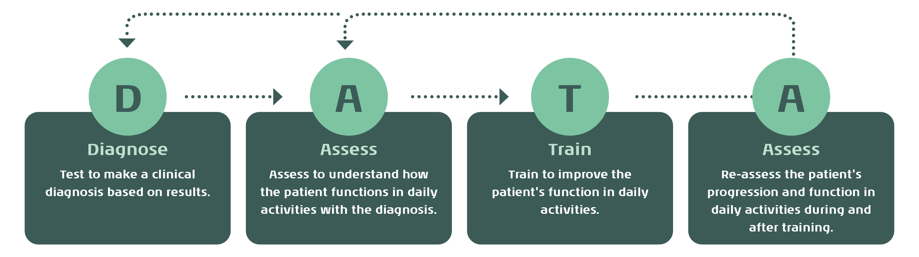
What are the components of the DATA model?

Slide 6
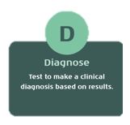
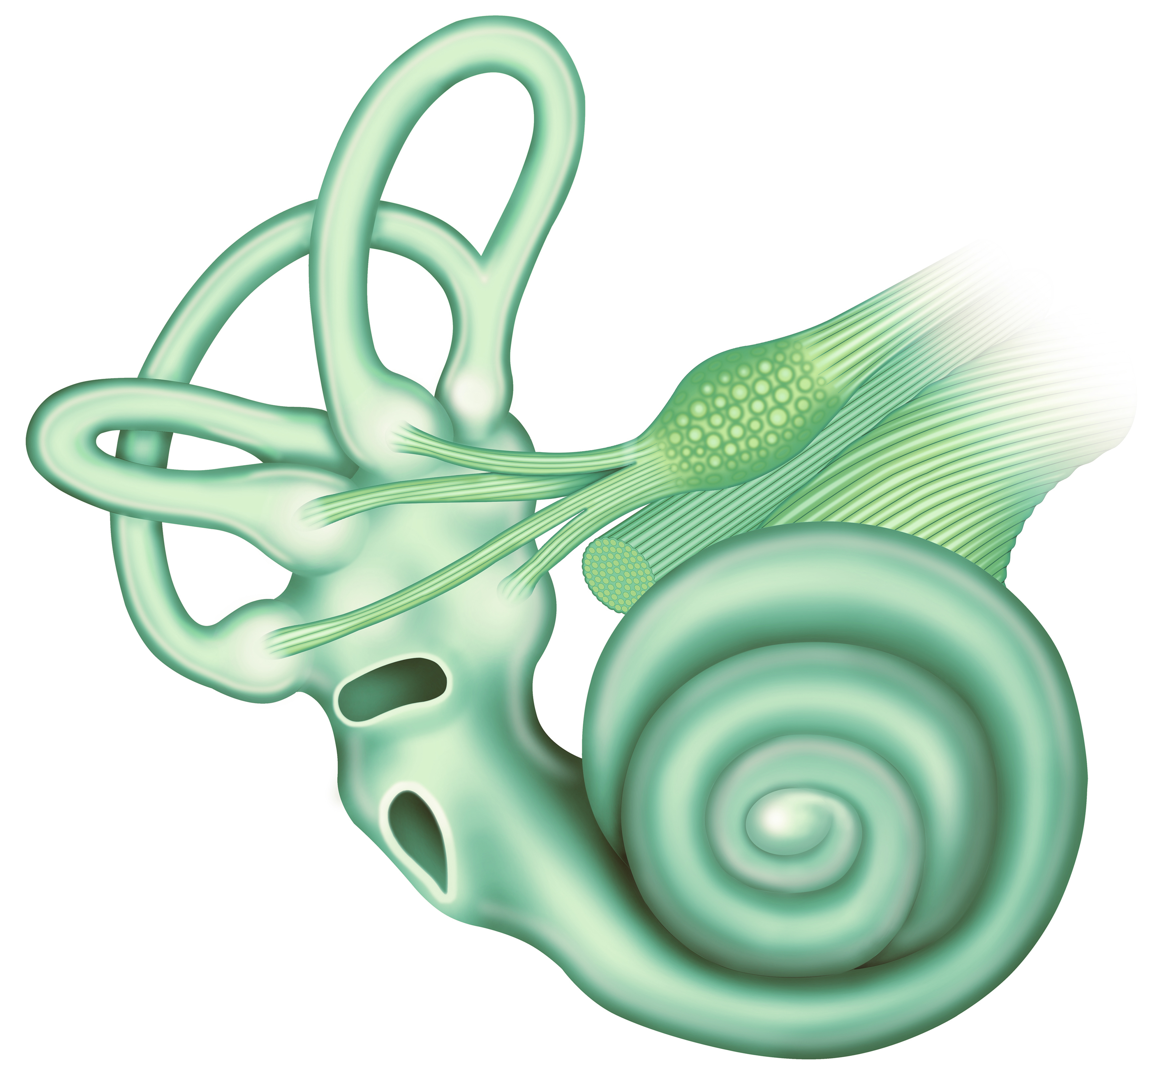

Diagnose: Step 1
Identify a clinical diagnosis based on site of origin
Utilize precise diagnostic tools for comprehensive assessment
VNG, Rotary chair, vHIT, Calorics, VEMPs, VORTEQTM Assessments/Diagnostics
Objective results provide optimal and accurate foundation for developing effective rehabilitation plan for the patient
Notes:
When any patient enters your clinic with symptoms, the first important step is to identify a clinical diagnosis based on site of origin. For dizziness, and especially vestibular disorders, diagnostic tests allow us to accurately identify site of origin for the potential disorder. In vestibular testing, we are utilizing a variety of precise diagnostic tools to ensure a comprehensive assessment of the peripheral vestibular organs. These tools include videonystagmography, rotational chair, video head impulse (vHIT), caloric, and vestibular evoked myogenic potential (VEMP) testing.
Diagnostic testing allows clinicians to determine the function of certain parts of the peripheral and central vestibular system. Objective results from this testing provide an optimal and accurate foundation for developing an effective treatment plan for the patient

Slide 7
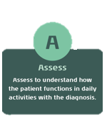
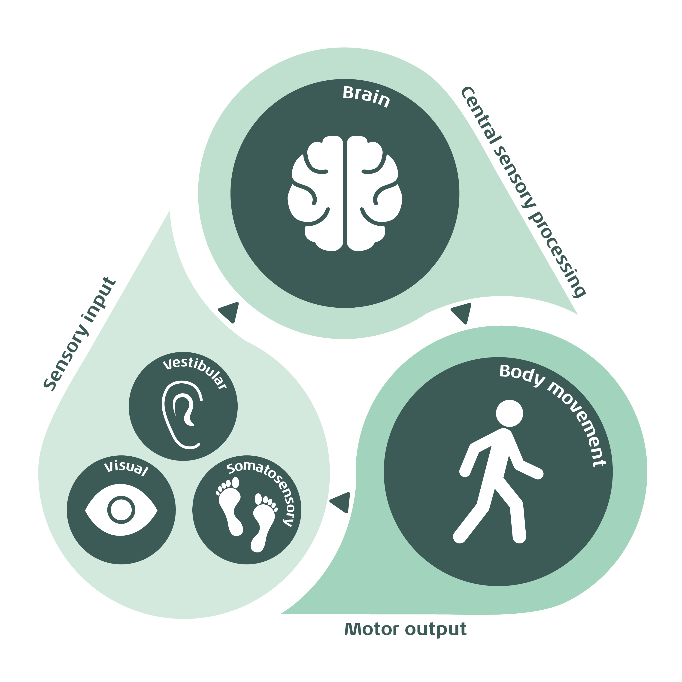
Assess: Step 2
Understand how the patient is functioning in their daily activities with their clinical diagnosis
Important to assess entire balance system: sensory input, central processing and motor output
VORTEQTM Assessments (DVA/GST/fvHITTM), Virtualis assessments (SOT/CTSIB, MCT, ADT, LOS)
Objective data to initiate and modify customized training programs
DVA: Dynamic Visual Acuity, GST: Gaze Stabilization Test, fvHITTM : Functional Vision Head Impulse Test, SOT: Sensory Organization Test, CTSIB: Clinical Test of Sensory Interaction on Balance, MCT: Motor Control Test, ADT: Adaptation Test, LOS: Limits of Stability
Notes:
Once a clinical diagnosis is established, the next step involves assessing how the patient is functioning with their clinical diagnosis. Two patients may have the same origin site of dysfunction but may experience different degrees of functional limitations. Depending on the patient and their specific diagnosis, the clinician may need to assess one or more areas such as gaze stability, sensory organization, and balance control. These assessments include computerized dynamic visual acuity or gaze stabilization testing utilizing a head worn VORTEQ sensor and limits of stability with clinical dynamic posturography assessessments using the Virtualis static or dynamic platforms.
It remains crucial for clinicians to rely on objective data to conduct a thorough assessment and initiate appropriate training.
@Cassandra Anderson (CSAS) maybe you can fill in specific examples of the equipment used in each category

Slide 8
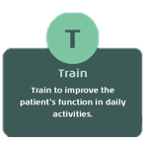
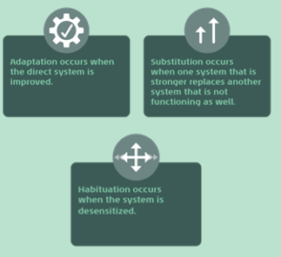
Training: Step 3
Customized to the patient based on diagnostic and assessment results
Improve the patient’s daily function, so they do not feel limited by their disorder through adaptation, substitution and habituation strategies
Virtualis virtual reality solutions
Objective data to monitor patient’s response and progress appropriately
Notes:
Following diagnosis and assessment, if training is necessary, the clinician should concentrate on exercises aimed at improving the patient's performance in their daily tasks. The goal of the training step is to improve the patient’s daily function, so they do not feel as limited or restricted by their disorder. Depending on the type of disorder or site of origin, recovery of the physiologic mechanism may not be realistic. This is why common balance rehabilitation strategies to improve function include adaptation, substitution, and habituation. Training exercises can utilize the Virtualis virtual reality headset for personalized immersive activities along with proactive and reactive postural control exercises using the Virtualis static or dynamic platforms to stimulate the full balance system.
Clinicians must closely monitor the patient's response to training and adjust exercises accordingly to ensure progression. Again, observing patient data at this stage of the process can dictate changes in training and additional interventions or strategies.
Insert equipment or exercise examples

Slide 9
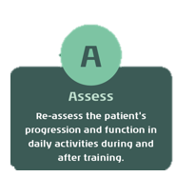
(re)Assess: Step 4
The DATA model is dynamic, requiring clinicians to reassess the patient’s status during and after training
  May involve returning to Step 1 (diagnose) and/or Step 2 (assess) depending on the patient
  Objective data plus the patient’s subjective report leads to a stronger argument for discharge
Notes:
The DATA approach remains dynamic, requiring clinicians to continually reassess the patient's daily functional status during and after training. Reassessment may involve returning to the diagnostic tests and/or additional assessment tools depending on the patient’s history and current presentation. A patient’s discharge from formalized therapy typically occurs when a patient returns to functioning in their daily activities. A stronger argument for the decision to discharge a patient is rooted in objective data and patient’s subjective improvement.

Slide 10
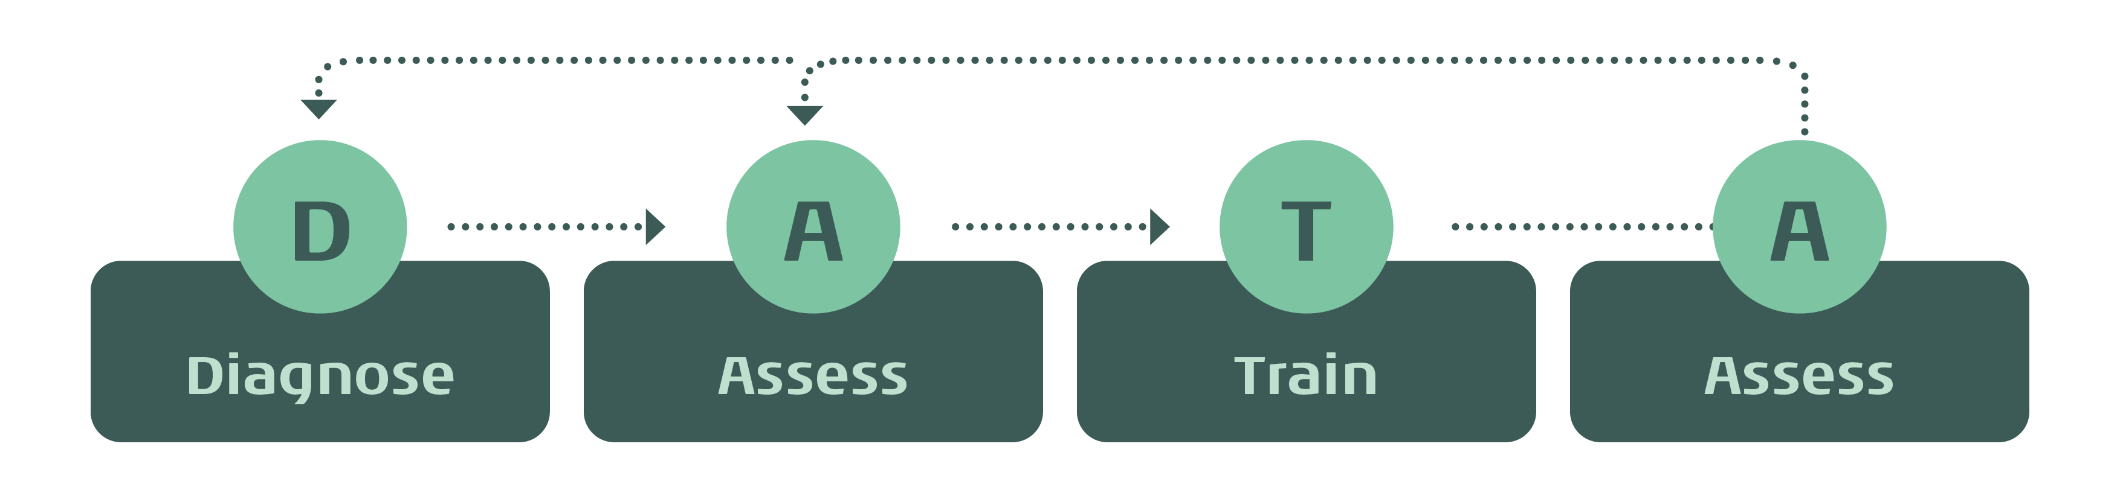
Setting the standard with a data-driven approach
The DATA model by Interacoustics
a framework for care that utilizes patient-specific objective data to support clinical decision-making for intervention and follow-up
High quality data stored in one centralized database

Slide 11

Good data in equals good data out!
vHIT
Calorics
VNG
Rotational Chair
VOR function
Posturography
Speed
Frequency
Sway
vHIT
VOR function
Posturography

Slide 12



Putting it all together...
Successful use of the DATA model requires:
Knowledgeable and skilled professionals with strong clinical judgment
Comprehensive diagnostic, assessment and training tools
Precise and objective data in all steps to guide clinical decision making

Slide 13
An evolving framework...
As our products expand, machine learning models are continuously integrated and refined through ongoing research. While we don’t yet include every component of the model across all markets, this framework can be used as a foundational guide to support the patient journey.

Slide 14
The DATA model by Interacoustics
Good data in equals good data out

