Slide 1
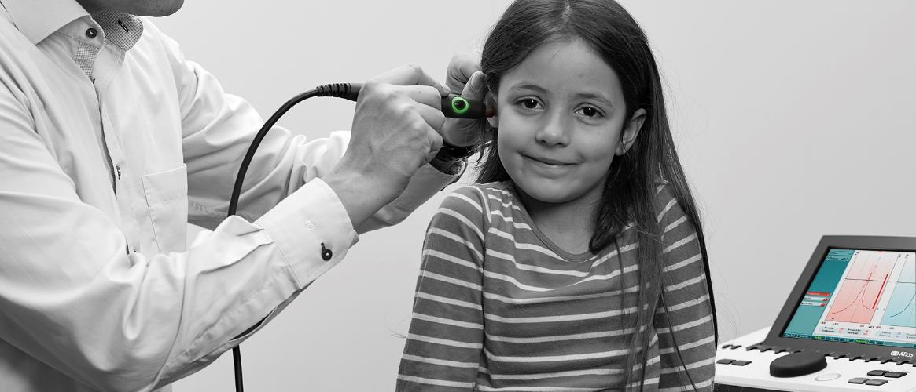
AT235
Introduction for Distributors and Sales Companies
31.01.2019 Name Surname

Slide 2
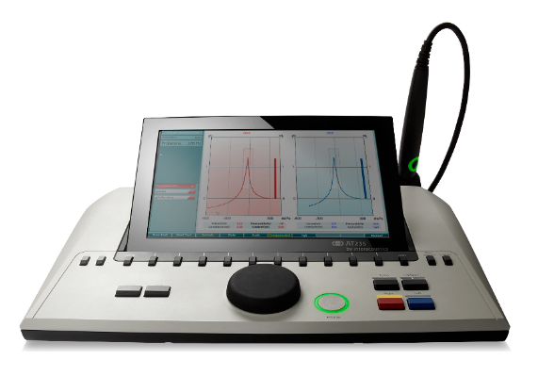
Agenda
Introduction
Target audience and segments
Features
Key selling points
Selling against
Competitor comparison
Interacoustics’ tympanometer comparison
Overview of material on extranet
Test battery
Headsets & transducers
Accessories
Technical specifications

Slide 3


Target audience and segments
Private ENT doctors
Doctors/General practitioners
Educational
institutions
Hearing
aid
dispensers
Hospitals

Slide 4
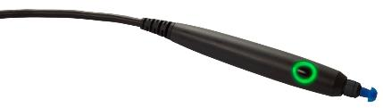
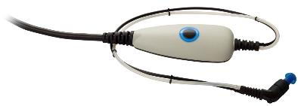
Diagnostic probe (standard)
Clinical probe
  Handheld for quick tymps and a screening reflex
  Ideal for lengthy examinations where stability is important
  Prevent rattling noise by placing the shoulder box on the client by using hardband, clips or keyhanger

Slide 5
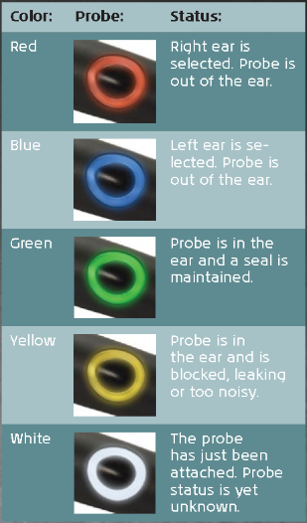
Dedicated probe systems
Easy to change between the probe in a matter of seconds
  No time wasted when seeing a client
Probe status displayed on probe and shoulder box
  Enables the user to keep focus on the clients

Slide 6
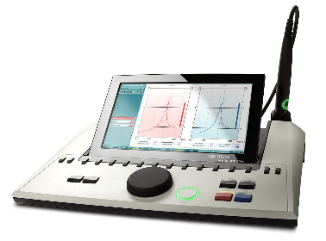
Extended pressure and more
+400daPa to -600daPa
  Enables users to make the Fistula test
  Meet the tender specification in certain countries
Up to 500 clients and 50,000 tests
  Makes it the optimum solution if
  travelling between sites
No light reflections
  The display can be adjusted to avoid reflections
Connect to TV or projector
  Great for counseling and educational purpose

Slide 7
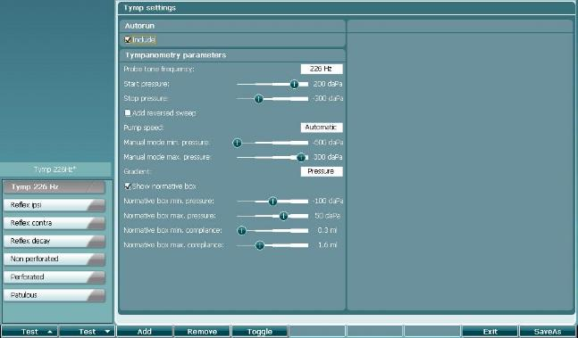
User defined protocols
Combining different tests into one test flow
Several protocols can be made
  E.g. create a simple screening protocol and a protocol for more in-depth evaluation
  Avoid wasting time adjusting to different client types as each test protocol can have separate test limits to meet the need of a specific client types

Slide 8
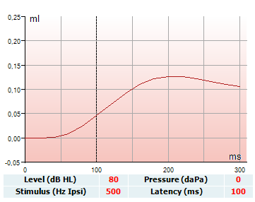
Reflex latency
ETF 3 Patulous Eustachian tube
Measures response time of middle-ear muscle contraction
Monitors changes in impedance over time without applying pressure changes or acoustic stimuli
With a patulous Eustachian tube you would typically expect to recognize the breathing of the patient in the tympanometry curve

Slide 9
Direct printing
Direct printing to both 3 inch and PC printers
Eliminates the need for a PC when there only is a need for printing the measurement

Slide 10
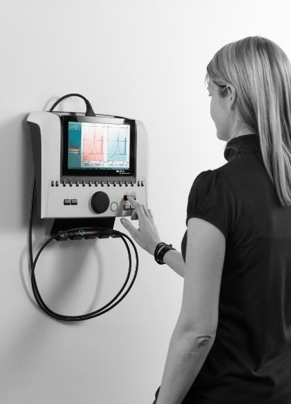



Wall mount
Optional bracket for wall mounting
Possible to use a standard bracket with VESA mounting that can be bought in many TV stores
Suitable for test rooms with limited desk space

Slide 11
















Display texts in several languages
Chinese
Greek
Turkish
English
German
Italian
Japanese
Finnish
Spanish
Norwegian
Korean
Russian
French
Polish
Portuguese

Slide 12
Features summary
Dedicated diagnostic and clinical probe with bigger status light indication
Pressure range from +400daPa to -600daPa (old: +300daPa to -600daPa)
Up to 500 clients and 50,000 sessions
HDMI output
Customizable protocols
Eustachian Tube Function – Patulous Eustachian Tube
Reflex latency test
Direct printing to PC-printers
Wall mount option for saving desk space
More languages: Chinese, English, Finnish, French, German, Greek, Italian, Japanese, Korean, Norwegian, Polish, Portuguese, Russian, Spanish and Turkish

Slide 13


The four key selling points
Customizable protocols => No time wasted on adjusting when seeing a client which results in faster testing
10” adjustable color display & HDMI => Great visibility of test results
Direct printing => Eliminating the need for a PC when operating standalone
More languages => Easier use of instrument

Slide 14
Selling against OTOflex 100
Competitor | Advantages
OTOflex 100 | Patulous Eustachian tube function test which can be used for cochlear implant fitting and detect if a patulous Eustachian tube is present A handheld probe is available for fast screenings 223x125mm display vs. 128x128mm providing a better overview of test results Screening audiometry Auto HL audiometry

Slide 15
Selling against Madsen Zodiac
Competitor | Advantages
Madsen Zodiac | Low pass, high pass and wideband noise stimuli for Ipsi and Contra reflex testing => screening the whole cochlear Reflex latency test which can evaluate if there is a prolongation of the reflex latency Patulous Eustachian tube function test which can be used for cochlear implant fitting and detect if a patulous Eustachian tube is present A handheld probe is available for fast screenings Weight 2.5kg vs. 7.6kg making it more suitable to carry to other sites Auto HL audiometry

Slide 16
Selling against Oscilla TSM300
Competitor | Advantages
Inmedico Oscilla TSM300 | High probe tones for babies younger than 6 months Measures from +400 to -600daPa where TSM300 only measures from +200 to -300daPa, so AT235 can do the Fistula testing (balance test) Manual pump control for flexibility in testing Low pass, high pass and wideband noise stimuli for Ipsi and Contra reflex testing => screening the whole cochlear Reflex decay Reflex latency test which can evaluate if there is a prolongation of the reflex latency Programmable test sequences, so no time waster on adjusting the unit when seeing clients Three different Eustachian tube function test to evaluate the function of the Eustachian tube A clinical probe ideal for more lengthy exams where stability is important and noise from rattling should be avoided Screening audiometry Auto HL audiometry

Slide 17
Selling against Oscilla TSM400
Competitor | Advantages
Inmedico Oscilla TSM400 | High probe tones for babies younger than 6 months Measures from +400 to -600daPa where TSM400 only measures from +200 to -300daPa, so AT235 can do the Fistula testing (balance test) Manual pump control for flexibility in testing Low pass, high pass and wideband noise stimuli for Ipsi and Contra reflex testing => screening the whole cochlear Reflex decay Reflex latency test which can evaluate if there is a prolongation of the reflex latency 3 different Eustachian tube function test to evaluate the function of the Eustachian tube A clinical probe ideal for more lengthy exams where stability is important and noise from rattling should be avoided 10” display vs. 7.2” providing a better overview of test results Screening audiometry Auto HL audiometry

Slide 18
Selling against Inventis Clarinet
Competitor | Advantages
Inventis Clarinet Plus | Patulous Eustachian tube function test which can be used for cochlear implant fitting and detect if a patulous Eustachian tube is present A handheld probe is available for fast screenings 223x125mm display vs. 150x90mm providing a better overview of test results Screening audiometry Auto HL audiometry

Slide 19
Selling against Inventis Flute - HF
Competitor | Advantages
Inventis Flute - HF | Manual pump control for flexibility in testing Low pass, high pass and wideband noise stimuli for Ipsi and Contra reflex testing => screening the whole cochlear Reflex decay Reflex latency test which can evaluate if there is a prolongation of the reflex latency Patulous Eustachian tube function test which can be used for cochlear implant fitting and detect if a patulous Eustachian tube is present A handheld probe is available for fast screenings 10” display vs. 4.3” providing a better overview of test results Screening audiometry Auto HL audiometry

Slide 20
Selling against GSI Tympstar
Competitor | Advantages
GSI Tympstar | Measures from +400 to -600daPa where Tympstar only measures from +300 to -600daPa, so AT235 can do the Fistula testing (balance test) Reflex latency test which can evaluate if there is a prolongation of the reflex latency Patulous Eustachian tube function test which can be used for cochlear implant fitting and detect if a patulous Eustachian tube is present A handheld probe is available for fast screenings 10” display vs. 5.9” providing a better overview of test results Weight 2.5kg vs. 7.5kg making it more suitable to carry to other sites Screening audiometry Auto HL audiometry

Slide 21
Selling against Maico MI44
Competitor | Advantages
Maico MI44 | Measures from +400 to -600daPa where MI44 only measures from +200 to -600daPa, so AT235 can do the Fistula testing (balance test) Reflex latency test which can evaluate if there is a prolongation of the reflex latency Patulous Eustachian tube function test which can be used for cochlear implant fitting and detect if a patulous Eustachian tube is present 223x125mm display vs. 100x76mm providing a better overview of test results Screening audiometry Auto HL audiometry

Slide 22
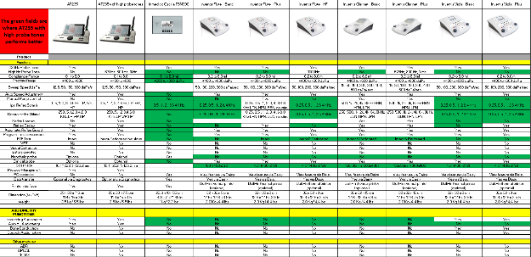
Competitor comparisons
More comparisons in the ”General Impedance Benchmark AT235 version” in the sales tool box.
For easy reading, fields are marked green where AT235/AT235h outperforms the competitor

Slide 23
Products covered in the comparison sheet
AT235 Blackline
AT235h Blackline
AA222 Blackline
AA222h Blackline
MT10 w/o reflex
MT10 with reflex
Titan Screening
Titan Diagnostics
Titan Clinical
GSI Tympstar V1
GSI Tympstar V2
GSI 39
Maico EasyTymp
Maico EasyTymp Pro
Maico RaceCar Tymp
Maico MI24
Maico MI26
Maico MI34
Maico MI44
Amplivox Otowave 102
Amplivox Otowave 202
Madsen Otoflex 100 Quick check
Madsen Otoflex 100 Diagnostic
Madsen Zodiac
Inmedico Oscilla TSM300
Inmedico Oscilla TSM400
Inventis Flute – Basic
Inventis Flute – Plus
Inventis Flute – HF
Inventis Clarinet – Basic
Inventis Clarinet – Plus
Inventis Viola – Basic
Inventis Viola - Plus

Slide 24
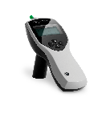
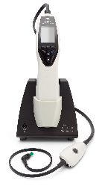

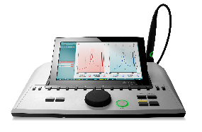
Interacoustics tympanometer comparison
Tests | New AT235 | New AT235h | Titan IMP screen. | Titan IMP Diag. | Titan IMP Clinical | MT10
Tymp 226Hz | X | X | X | X | X | X
Tymp 679, 800 & 1000Hz |  | X | Option | Option | X | -
Manual tympanometry |  | X | - | - | X | -
Reflex Ipsi lateral | X | X | X | X | X | Option
Reflex Contra lateral | X | X | - | X | X | -
EFT 1 test non-perforated tympanic membrane | X | X | - | X | X | -
EFT 2 test perforated tympanic membrane | X | X | - | - | X | -
EFT 3 test patulous Eustachian tube |  | X | - | - | X | -
Reflex decay | X | X | - | X | X | -
Reflex latency |  | X | - | - | X | -
Pure tone audiometry | X | X | - | - | - | -
Modified Hughson Westlake audiometry test | X | X | - | - | -
WBT (Absorbance & tympanometry) | - | - | - | Option | Option | -
WBT research mode | - | - | - | Option | Option | -

Slide 25
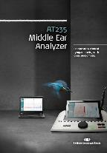
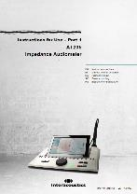
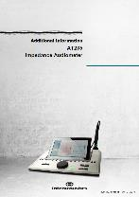
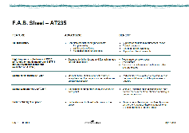

Material on the extranet
PowerPoint – end users
Brochure
Features, advantages and benefits sheet
Advertisement
Elevator pitch
Product comparison
Release note end user
Instructions for use
Additional information
Technical specification
Service manual
Roll-up
Poster
Postcard

Slide 26
Test battery
Tests | AT235 | AT235h
Tymp 226Hz | X | X
Tymp 679, 800 & 1000Hz |  | X
Manual tympanometry |  | X
Reflex ipsilateral | X | X
Reflex contralateral | X | X
EFT 1 test non-perforated tympanic membrane | X | X
EFT 2 test perforated tympanic membrane | X | X
EFT 3 test patulous Eustachian tube |  | X
Reflex decay | X | X
Reflex latency |  | X
Pure tone audiometry | X | X
Modified Hughson Westlake audiometry test | X | X

Slide 27
Headsets & transducers
Accessories
Group | Accessories | Optional/standard
Probe system | Diagnostic probe system | Standard
 | Clinical probe system | Optional
 | Both | Optional
Contra headset | DD45C contra headset | Standard
 | IP30 10 Ohm insert phone | Optional
 | HBC39 contra headset | Optional
 | CIR33 | Optional
Audiometric headset | DD45 Audiometric headset | Optional
 | TDH39 HBA headband | Optional
 | IP30 10 Ohm insert phone | Optional

Slide 28
Accessories
Accessories
Group | Accessories | Optional/standard
Instrument accessories | Clothing clip – neckstrap kit | Standard with the clinical probe system
 | Assortment BET55 | Standard
 | Probe floss kit | Standard
 | Printer kit | Optional
 | Wall mounting kit | Optional
 | Probe tip kit | Standard
 | APS3 Patient response switch | Optional
 | CAT50 | Optional
 | Power supply | Standard
 | Diagnostic probe holder kit | Standard with the diagnostic probe system
 | Carrying bag | Optional
Software | Sync mode & Diagnostic Suite | Optional
 | Sync mode, Diagnostic Suite & OtoAccess™ | Optional

Slide 29
Technical specifications
Medical CE-mark: | The CE-mark indicates that Interacoustics A/S meets the requirements of Annex II of the Medical Device Directive 93/42/EEC Approval of the quality system is made by TÜV – identification no0123
Standards: | Safety: | IEC 60601-1, Class I, Type B applied parts
 | EMC: | IEC 60601-1-2
 | Impedance: | IEC 60645-5/ANSI S3.39, Type 1
 | Audiometer: | IEC60645-1/ANSI S3.6, Type 4
Operation environment: | Temperature: | 15 – 35 °C
 | Relative Humidity: | 30 – 90%
 | Ambient Pressure: | 98kPa – 104kPa
 | Warm-up Time: | 1 minute
Transport & Storage: | Storage Temperature: Transport Temperature: Rel. Humidity: | 0°C – 50°C -20 – 50 °C 10 – 95%

Slide 30
Science made smarter
Interacoustics.com
info@interacoustics.com
(+45) 6371 3555

