Slide 1
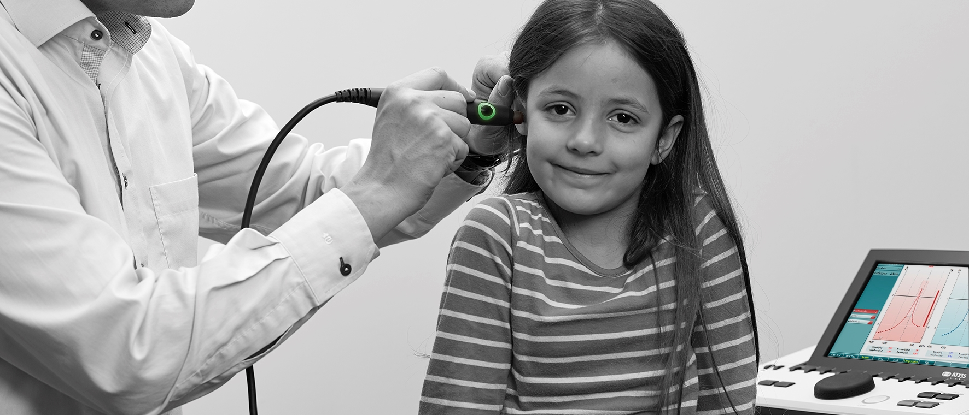
AT235
Introduction for users
31.01.2019 Name Surname

Slide 2
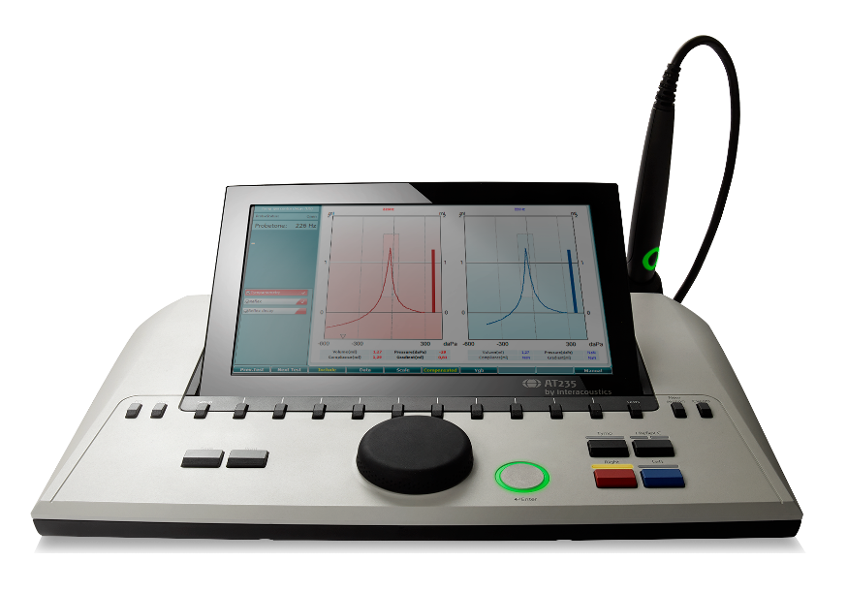
Agenda
Introduction
Target audience & segments
Main features & benefits
Other features & benefits
Headsets, accessories & technical specification

Slide 3
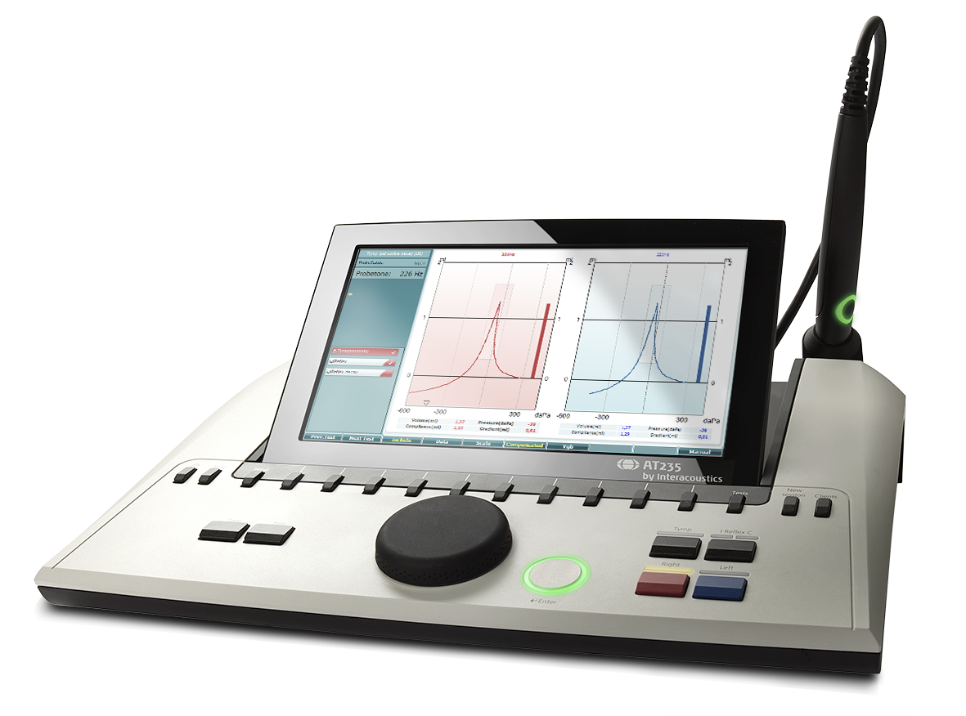
Introduction
Full clinical test battery
Customizable user protocols
Several languages
Direct printing
Flexible mounting
Dedicated diagnostic and clinical probe system with probe status light

Slide 4
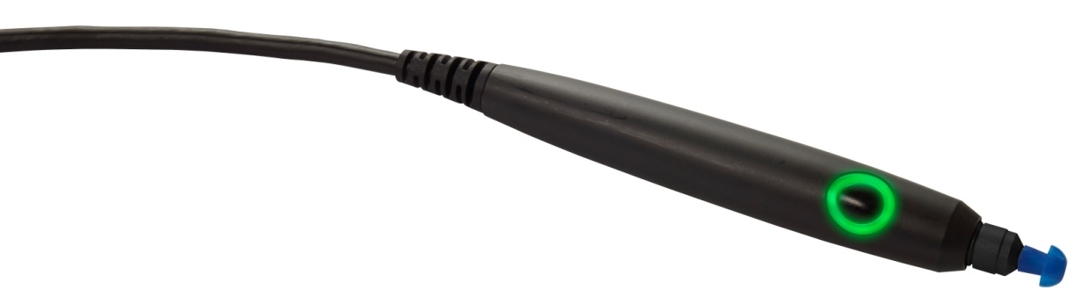
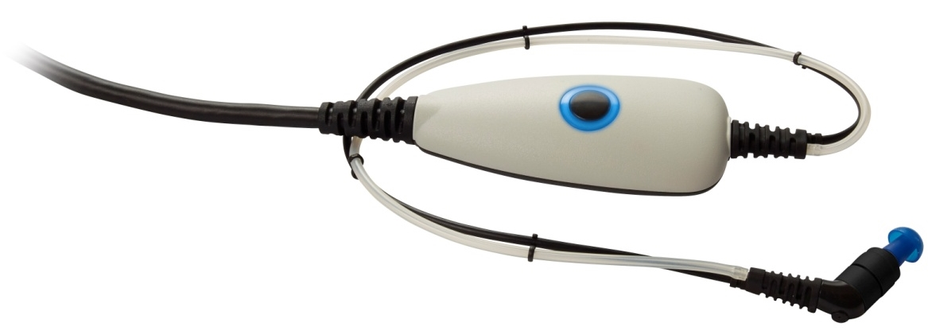
Diagnostic probe (standard)
Clinical probe
  Handheld for quick tymps and a screening reflex
  Ideal for lengthy examinations where stability is important
  Prevent rattling noise by placing the shoulder box on the client by using hardband, clips or keyhanger

Slide 5

Target audience & segments
Private ENT doctors
Doctors/General practitioners
Educational
institutions
Hearing
aid
dispensers
Hospitals

Slide 6
Main features, advantages & benefits

Slide 7
Full clinical test battery
Tests | AT235 | AT235h
Tymp 226Hz | X | X
Tymp 679, 800 & 1000Hz |  | X
Manual tympanometry |  | X
Reflex ipsilateral | X | X
Reflex contralateral | X | X
EFT 1 test non-perforated tympanic membrane | X | X
EFT 2 test perforated tympanic membrane | X | X
EFT 3 test patulous Eustachian tube |  | X
Reflex decay | X | X
Reflex latency |  | X
Pure tone audiometry | X | X
Modified Hughson Westlake audiometry test | X | X
Advantage
  Complete product for diagnostic tests
    Tympanometry
    Ipsi & contra reflexes
    Eustacian tube function tests
Benefits
  Support for multiple reimbursement codes
  Correct diagnosis
  Fast and efficient workflow
  Support for clinical research

Slide 8
Adjustable color display & HDMI
Advantages
  Several tests can be seen on the same screen
  Light reflection is avoided by tipping the display
  Test results can be shown on a TV or projector
Benefits
  Provides a good overview of test results
  Better counseling of clients
  Students can easily follow the test results

Slide 9
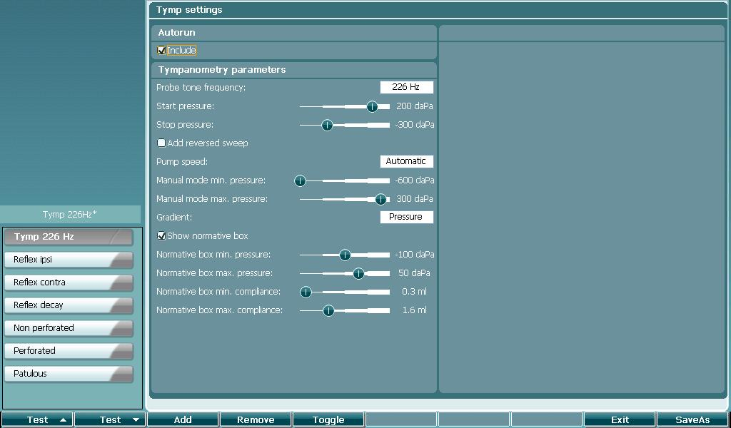
Customizable user protocols
Advantages
  Customize the tympanometer with your
  own preferred settings
  Easy switch from one protocol to another
  Create changes to the standard protocols
  on the fly while testing
Benefits
  Support for multiple users and workflows
  Increased efficiency when carrying out tests
  Easier to adjust alternative clinical test routines individually

Slide 10















Display texts in several languages
Chinese
Greek
Turkish
English
German
Italian
Japanese
Finnish
Spanish
Norwegian
Korean
Russian
French
Polish
Portuguese
Notes:
Feature:
Several languages supported in display
Advantage:
All the text on the screen is in local language
Benefits:
Testing can be done faster as the clinicians are familiar with the different terms

Slide 11
Direct printing
Direct printing to both 3 inch and PC printers
  Eliminates the need for a PC when there only is a need for printing the measurement
Advantage
  Easy printing without the need for a PC
Benefits
  Saves space for a PC in the office
  No need to bring a PC when traveling between sites

Slide 12
Other features, advantages & benefits

Slide 13
HF probe tone and ETF tests
Features:
High frequency probe tone (AT235h)
ETF 1 non-perforated tympanic membrane, EFT 2 perforated tympanic membrane (AT235) & ETF 3 patulous tympanic membrane (AT235h)
Advantage:
Equipped for infant testing and eustachian tube function diagnostics
Benefits:
Meets more complex needs
Tests infants
Tests for eustachian tube function

Slide 14
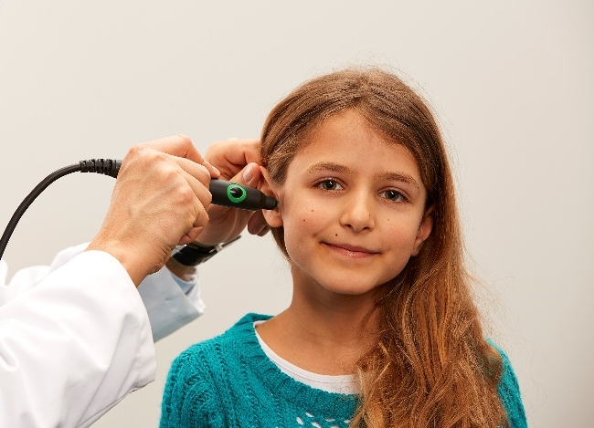
Manual reflex testing
Feature:
Manual reflex testing (AT235h)
Advantage:
Manual choice of stimuli and intensities
is available when the diagnostics
demands more precise investigation
Benefit:
Performs the test exactly as required, in case the protocol does not match special needs required

Slide 15
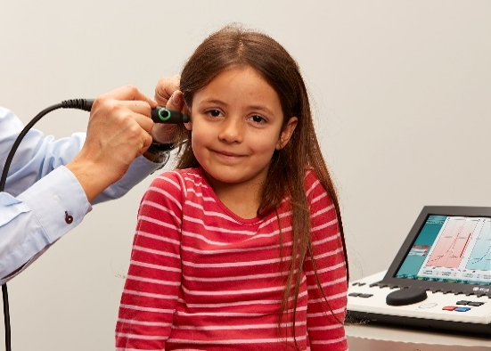
Manual tympanometry
Feature:
Manual tympanometry (AT235h)
Advantage:
Adjustment of pump pressure by the
wheel on front panel
Benefit:
With e.g. oscicular chain discontinuities more precise measurement is obtained resulting in a more correct diagnosis

Slide 16
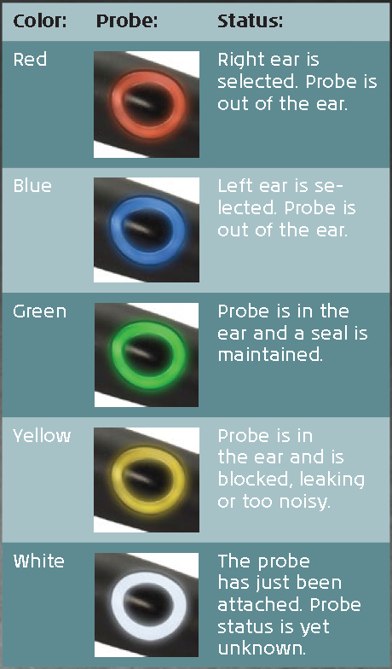
Dedicated probe systems
Easy to change between the probe in a matter of seconds
  No time wasted when seeing a client
Probe status displayed on probe and shoulder box
  Enables you to keep focus on the clients

Slide 17
User defined protocols
Combining different tests into one test flow
Several protocols can be made
  E.g. create a simple screening protocol and a protocol for more in-depth evaluation
  Avoid wasting time adjusting to different client types as each test protocol can have separate test limits to meet the need of a specific client types

Slide 18
Print wizard
Advantages:
  Clinic-to-clinic customized report/print outs
  Choose from a wide variety of flexible professional
  reports
  Merge data from several instruments into one report
  (audiometry, tympanometry and video otoscopy)
Benefits:
  More efficient workflow
  Professional appearance
  Paperless solution for EMR integration

Slide 19
Noah and OtoAccess™ compatible
Advantages:
  Fully Noah compatible for interfacing with fitting
  software modules
  Save audiograms directly in Noah
Benefits:
  Less manual work
  Save data in your database
  Share information with colleagues & other external people
  Less paperwork

Slide 20
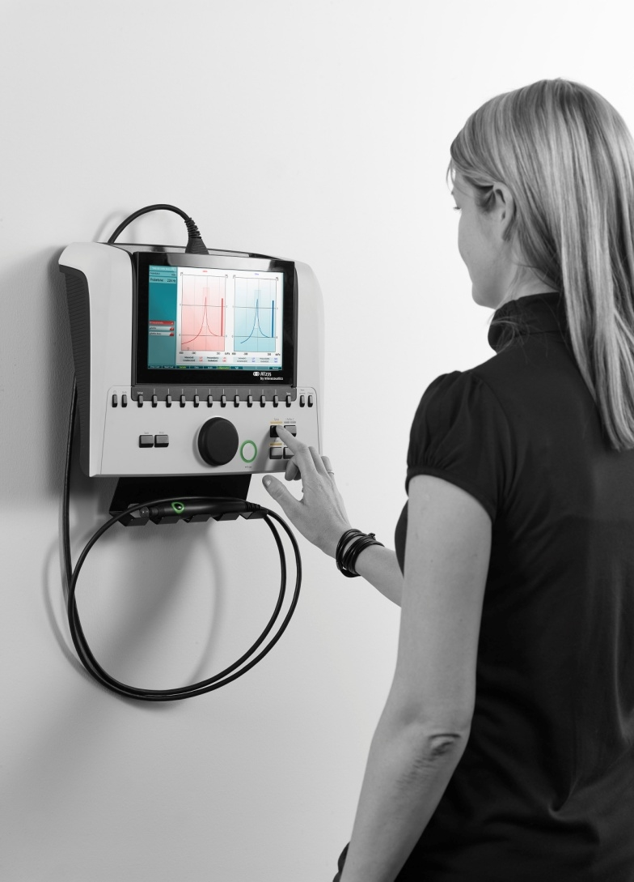

Wall mount
Optional bracket for wall mounting
Possible to use a standard bracket with VESA mounting that can be bought in many TV stores
Suitable for test rooms with limited desk space

Slide 21
Headsets, accessories & technical specification

Slide 22
Headsets & transducers
Accessories
Group | Accessories | Optional/standard
Probe system | Diagnostic probe system | Standard
 | Clinical probe system | Optional
 | Both | Optional
Contra headset | DD45C contra headset | Standard
 | IP30 10 Ohm insert phone | Optional
 | HBC39 contra headset | Optional
 | CIR33 | Optional
Audiometric headset | DD45 Audiometric headset | Optional
 | TDH39 HBA headband | Optional
 | IP30 10 Ohm insert phone | Optional

Slide 23
Accessories
Accessories
Group | Accessories | Optional/standard
Instrument accessories | Clothing clip – neckstrap kit | Standard with the clinical probe system
 | Assortment BET55 | Standard
 | Probe floss kit | Standard
 | Printer kit | Optional
 | Wall mounting kit | Optional
 | Probe tip kit | Standard
 | APS3 Patient response switch | Optional
 | CAT50 | Optional
 | Power supply | Standard
 | Diagnostic probe holder kit | Standard with the diagnostic probe system
 | Carrying bag | Optional
Software | Sync mode & Diagnostic Suite | Optional
 | Sync mode, Diagnostic Suite & OtoAccess™ | Optional

Slide 24
Technical specifications
Medical CE-mark: | The CE-mark indicates that Interacoustics A/S meets the requirements of Annex II of the Medical Device Directive 93/42/EEC Approval of the quality system is made by TÜV – identification no0123
Standards: | Safety: | IEC 60601-1, Class I, Type B applied parts
 | EMC: | IEC 60601-1-2
 | Impedance: | IEC 60645-5/ANSI S3.39, Type 1
 | Audiometer: | IEC60645-1/ANSI S3.6, Type 4
Operation environment: | Temperature: | 15 – 35 °C
 | Relative Humidity: | 30 – 90%
 | Ambient Pressure: | 98kPa – 104kPa
 | Warm-up Time: | 1 minute
Transport & Storage: | Storage Temperature: Transport Temperature: Rel. Humidity: | 0°C – 50°C -20 – 50 °C 10 – 95%

Slide 25
Science made smarter
Interacoustics.com
info@interacoustics.com
(+45) 6371 3555

